Slide 1
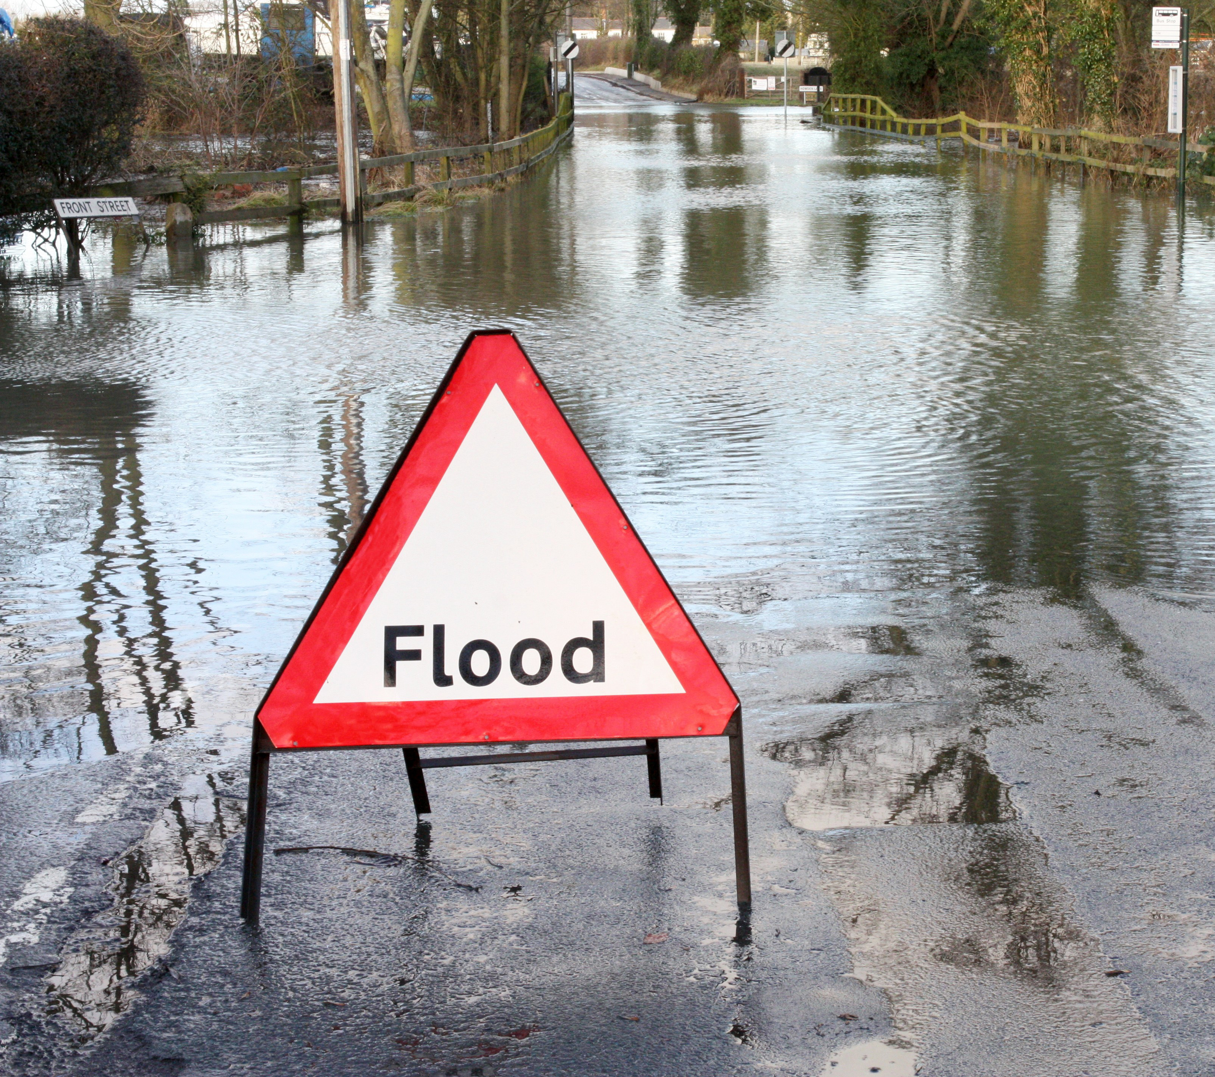
Assessing the application of land surface models for flood forecasting in the UK
Stamatis Batelis
University of Bristol
s.batelis@bristol.ac.uk

Slide 2
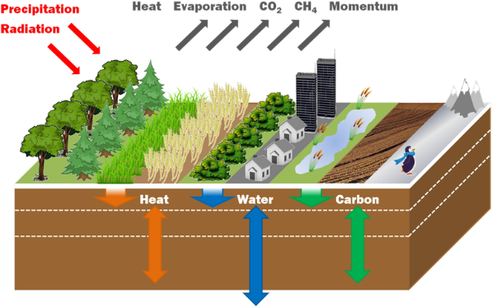
Motivation
Our motivation is to develop a new tool to predict flood in UK that will not need calibration for each catchment but it will be based on high resolution data.
Joint UK Land Environment Simulator (JULES)
www.wisecdt.org

Slide 3
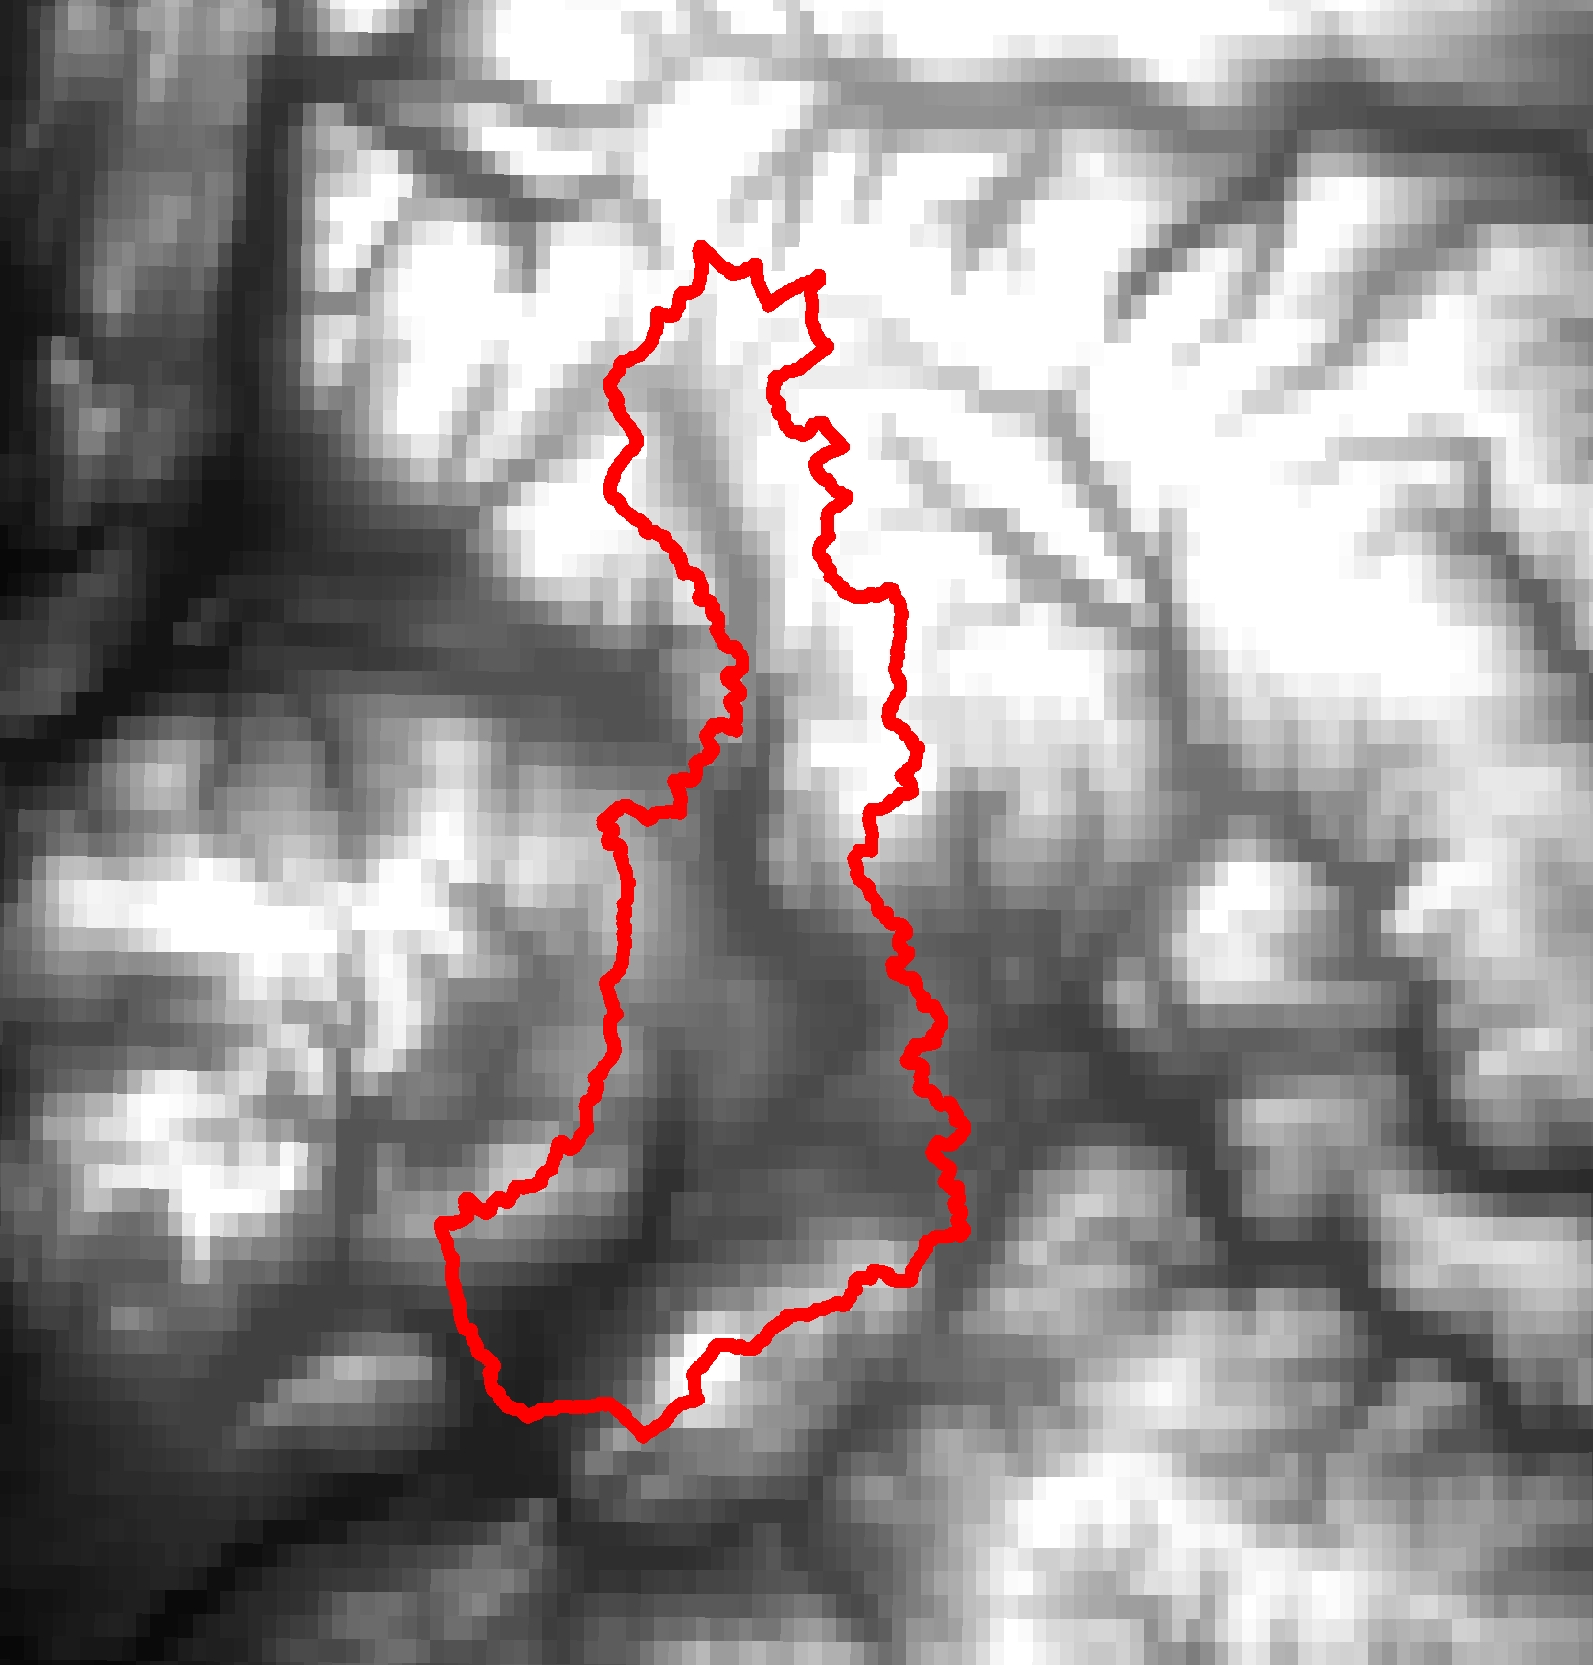
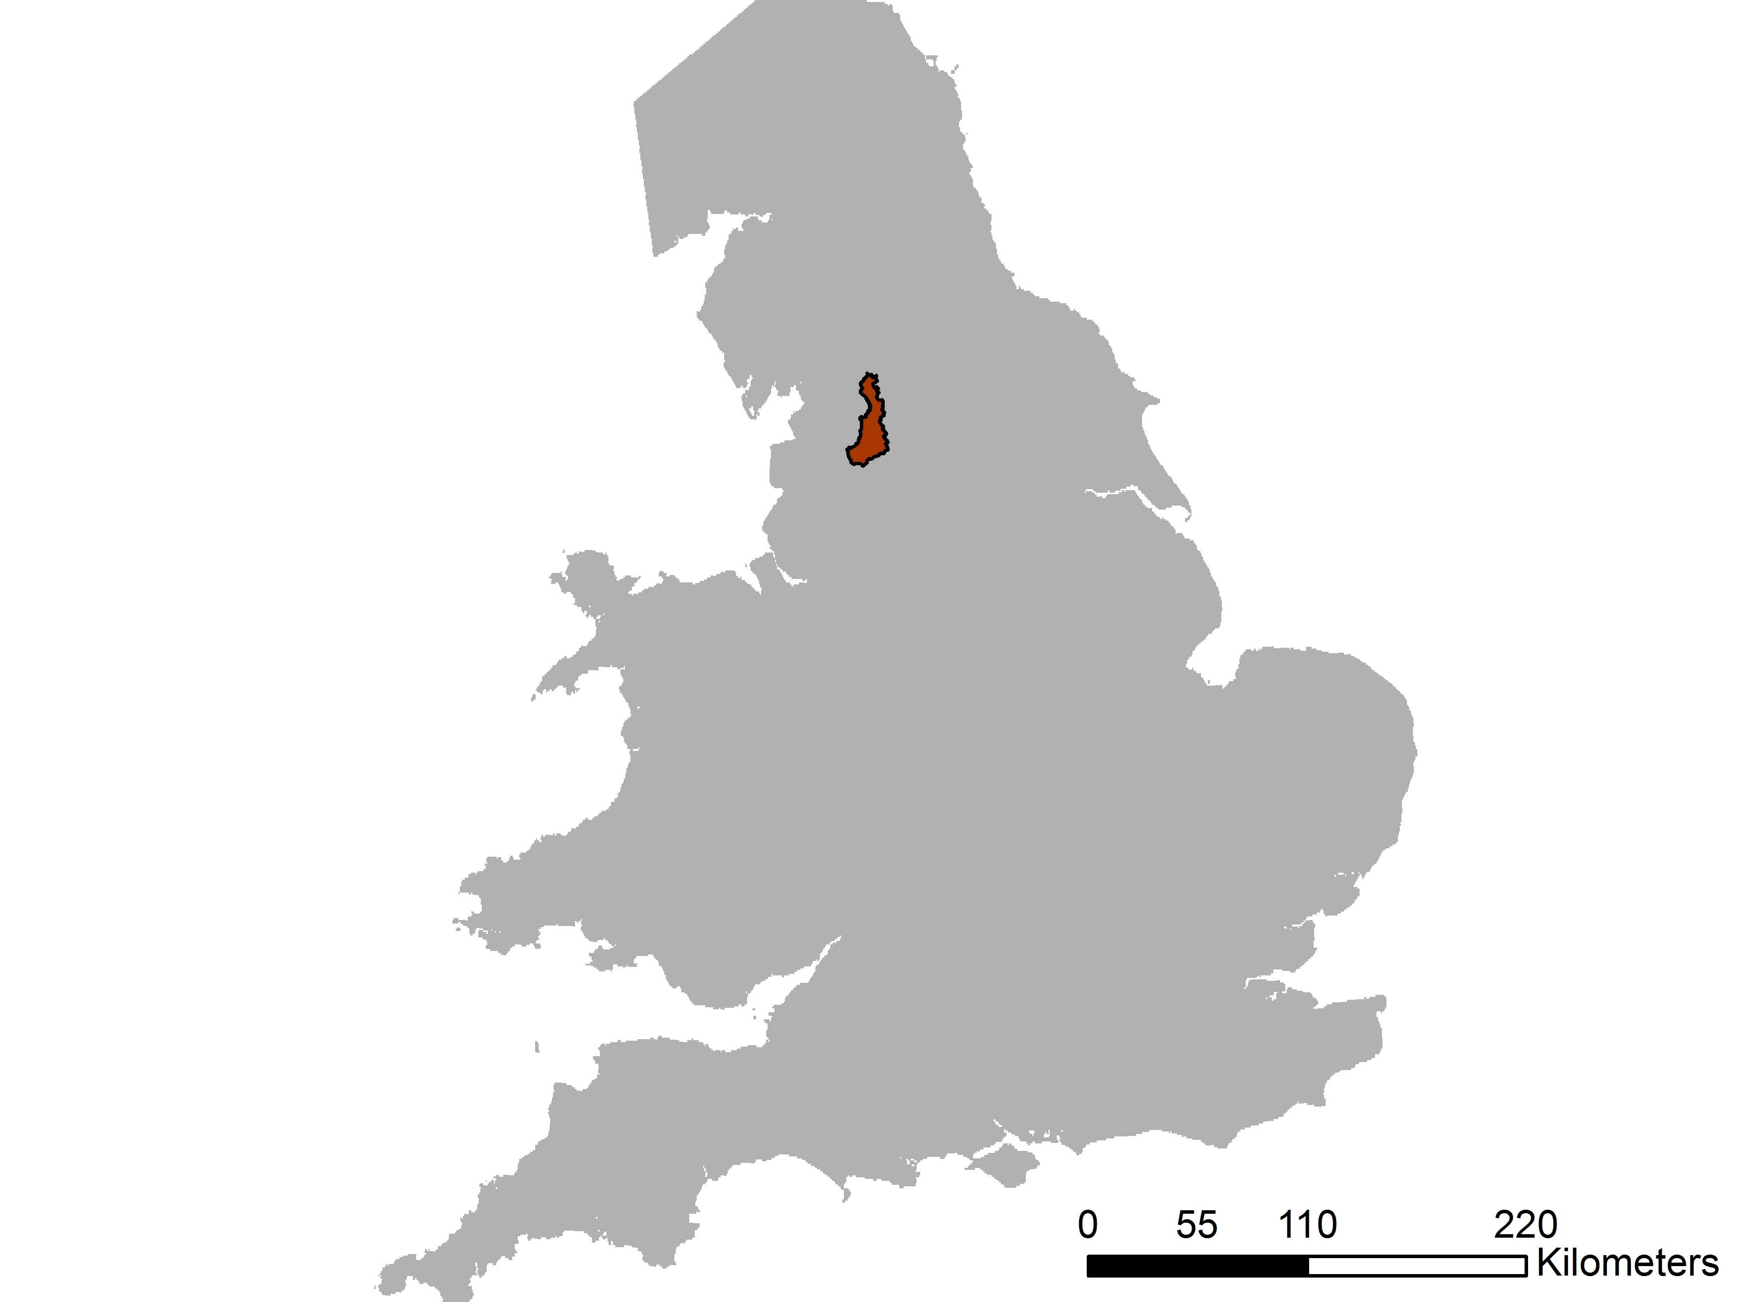
Study area – Experiments
We test different factors such as soil databases, river flow model schemes and use of a groundwater model in order to find which factor is more influential.
Name | Area (km²) | BFI | Runoff ratio
Ribble Cumbria and Lancashire | 456 | 0.31 | 0.7
www.wisecdt.org

Slide 4
Cranfield data vs. HWSD dataset
KGE_{Cranfield} = 0.62
KGE_{HWSD} = 0.56
www.wisecdt.org

Slide 5
Default river routing scheme vs. Manning
KGE_{Cranfield} = 0.62
KGE_{HWSD} = 0.56
KGE_{Default} = 0.616
KGE_{Manning’s} = 0.617
www.wisecdt.org

Slide 6
Results
The accuracy and the resolution of soil dataset play an important role
Same performance when using our Manning’s scheme compared to the default river flow model. However, Manning’s scheme directly introduces the effect of topography on the calculation of wave speeds, as opposed to the default scheme which rely on many universally defined wave speed constants implying only indirect influence from topography.
Further analysis
Our further analysis will investigate the role of groundwater interactions (not currently included in JULES).
Use more evaluation criteria to assess the results.
www.wisecdt.org

