Slide 1
For a deep understanding you need to go below the surface: groundwater processes in conceptual hydrological models
Sebastian Gnann, University of Bristol
Supervisors: Dr Nicholas Howden, Dr Ross Woods

Slide 2
1. Introduction
Groundwater discharge is often an important contribution to streamflow
Groundwater is poorly represented in conceptual catchment-scale models
2
www.wisecdt.org

Slide 3
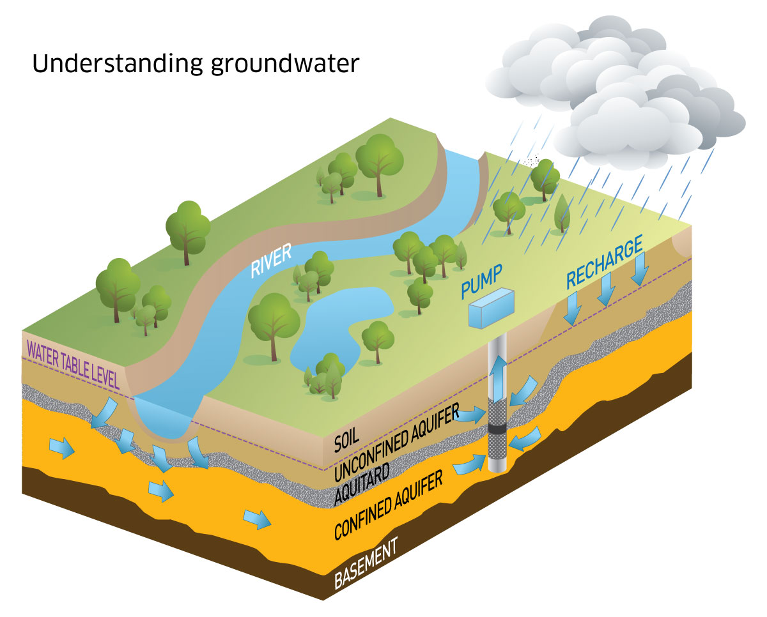
How to account for temporal and spatial heterogeneity across various scales?
2. Open questions
How are ground-water and river connected?
How to deal with recharge?
What types of aquifers are present?
How can we use groundwater level observations to improve our models?
How to handle inter-catchment groundwater flows or other abstractions like wells?
Image: https://www.mdba.gov.au/discover-basin/water/discover-groundwater
3
www.wisecdt.org

Slide 4
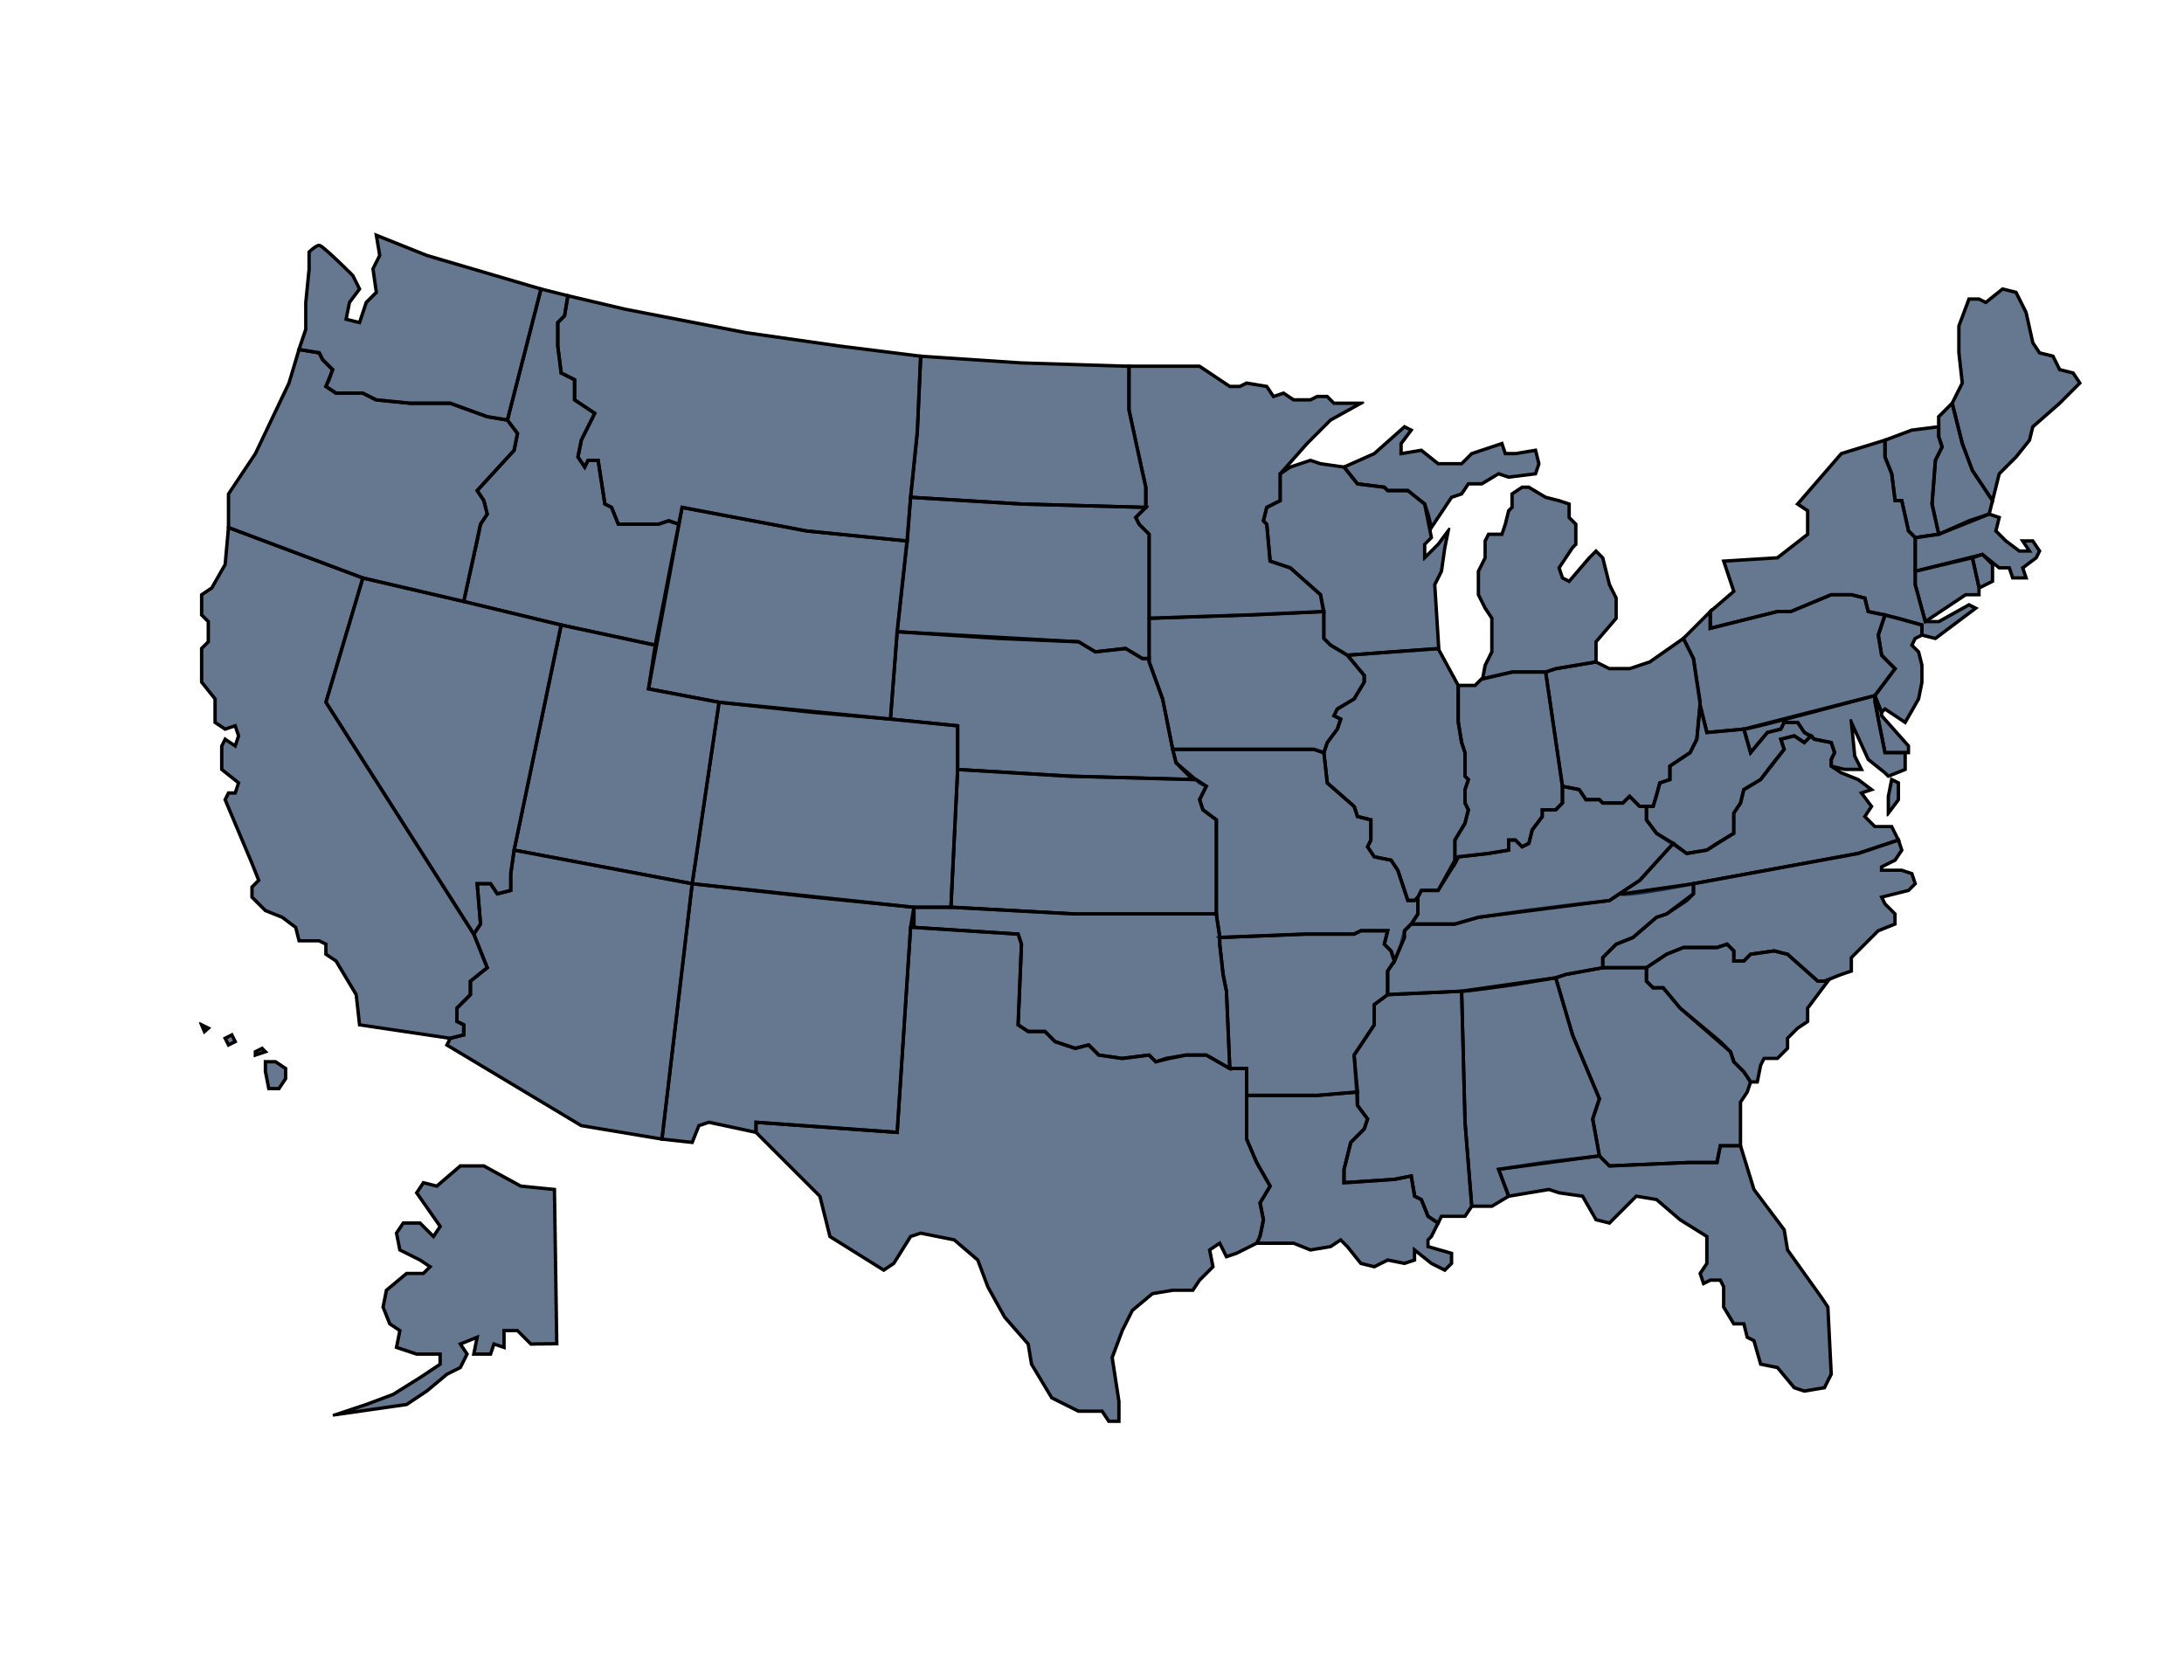
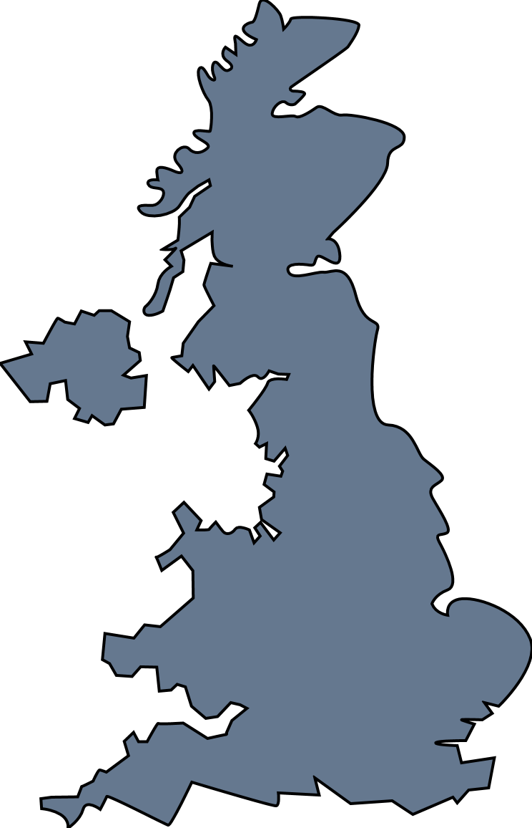
3. Data, methodology and approaches
Basic equations for groundwater flow
Physical parameters or measurements
Data
Conceptual catchment scale laws
Novel catchment-scale parameters
Novel conceptual model structures or improved existing ones
Integrate into existing models
Transfer to ungauged catchments
4
www.wisecdt.org

Slide 5
4. Aim
Build improved yet still parsimonious enough models that better represent groundwater processes at the catchment scale
5
www.wisecdt.org

