Slide 1
Richard Rees PhD Proposal:
Modelling of geotechnical instability within earthworks arising from coastal storm surges and prolonged flood inundation events.
Supervisor: Dr Shunqi Pan

Slide 2
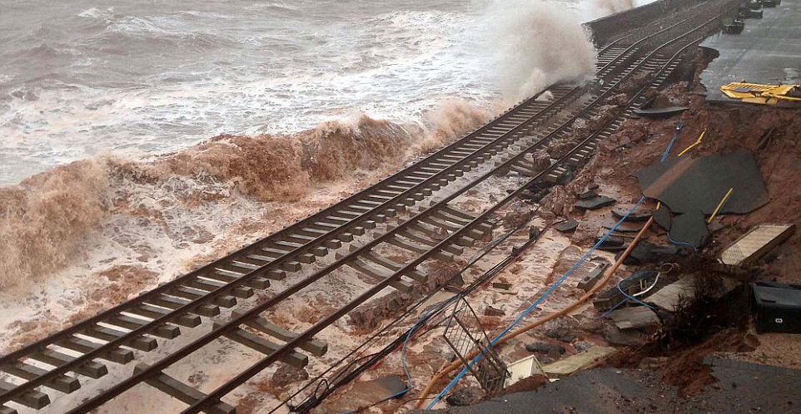
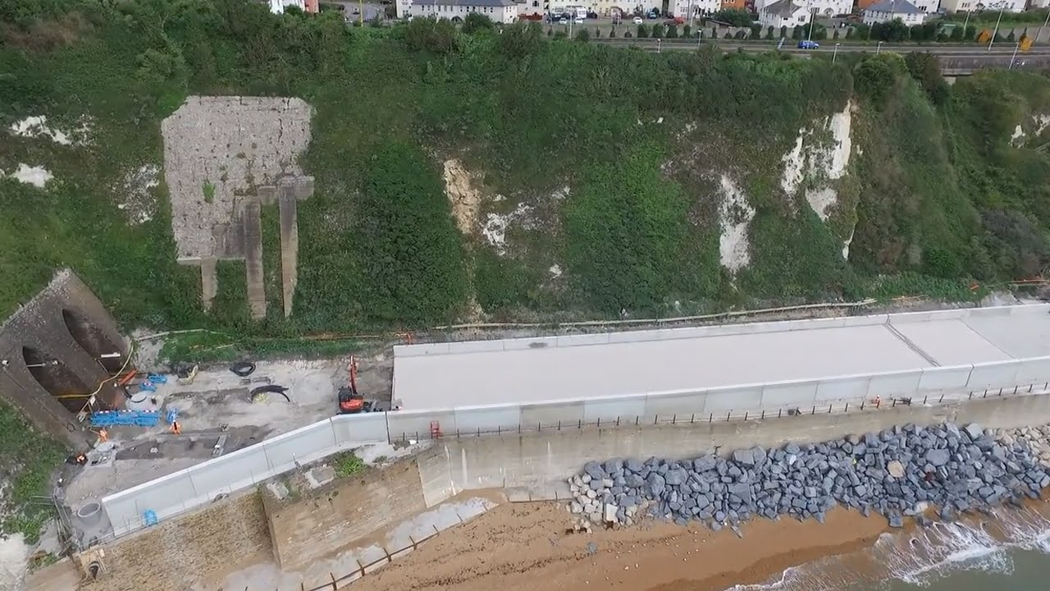
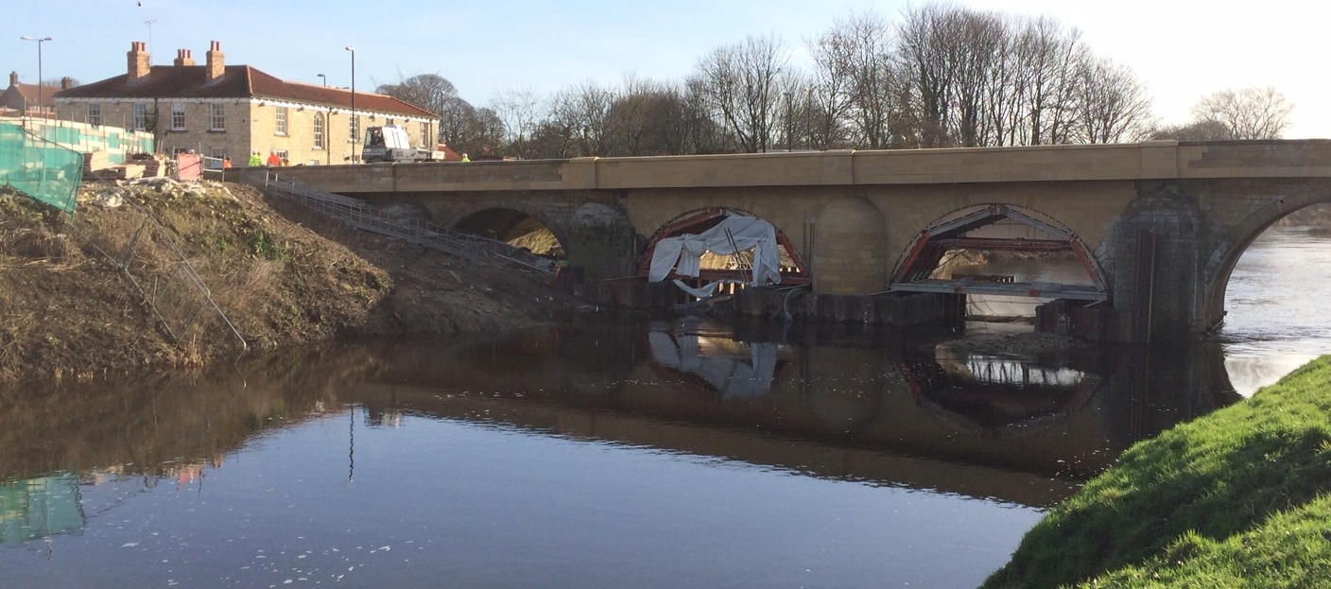
Introduction
Dawlish seawall breach - February, 2014
Recent Winters have generated successive powerful storm systems being strong winds and heavy rains.
Coastal and inland regions have suffered significant damage to defensive and transport infrastructure.
All have resulted in prolonged periods of disruption, expensive rebuilds, as well reduced economic output from the effected areas.
The most widely publicised typically involves heavy engineered civil structures.
What about geotechnical ‘earthwork’ based infrastructure?
Shakespeare Cliff seawall (Dover) – Complete rebuild – March, 2016
Tadcaster Bridge reopening, Feb 2017

Slide 3
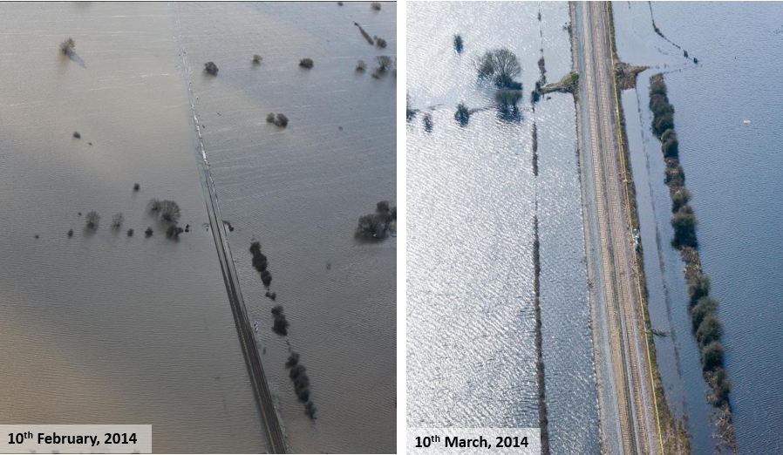
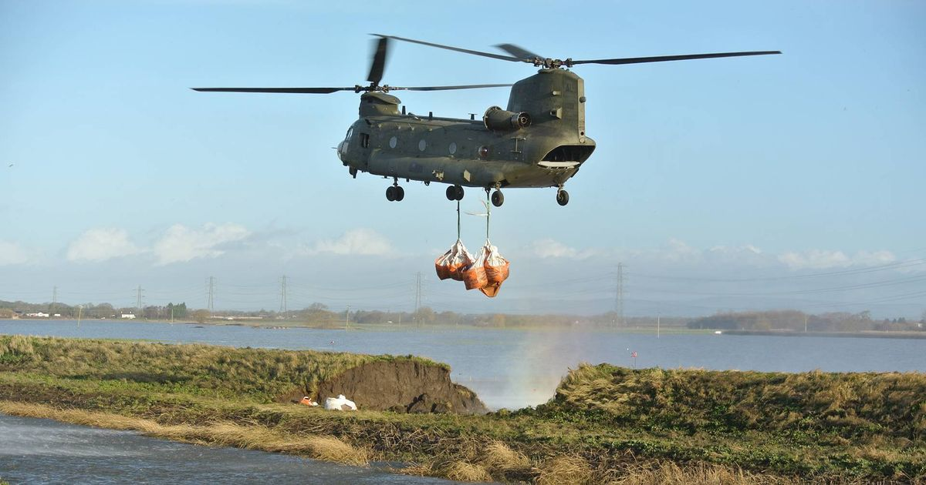
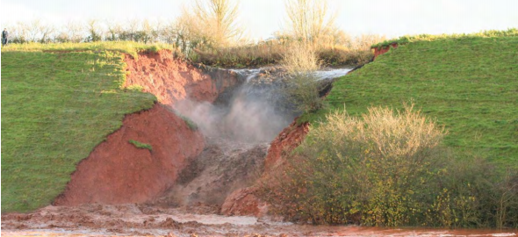
Geotechnical failures/damage
Somerset Levels (MLN, South of Bridgewater) – Flood water ~10m deep
Disruption to mainline railway services between Exeter and Bristol – Prolonged flooding of Somerset levels for over 6 weeks.
Multiple breaching near Corston of River Douglas.
Overtopping erosion of Great Western Canal leading to complete breach of structure.
Corston, Lancashire. River levee breach – 31st December, 2015.
Great Western Canal Breach – Halberton, Devon – November, 2012

Slide 4
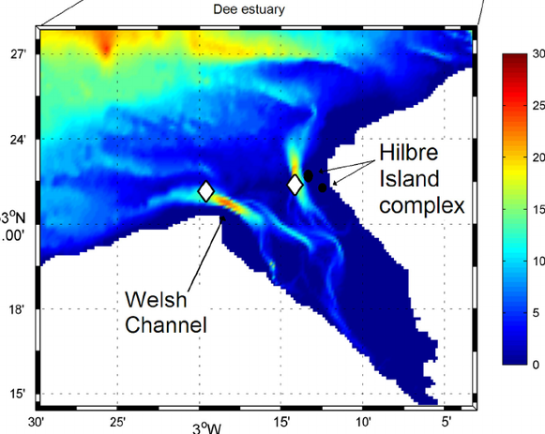
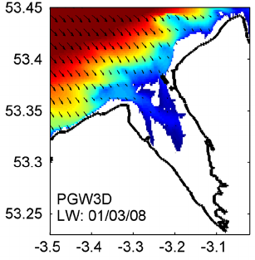

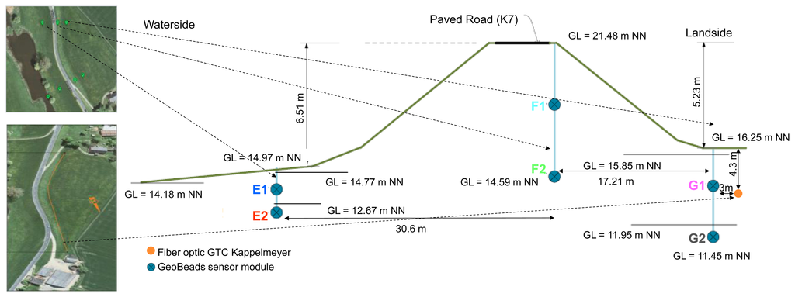
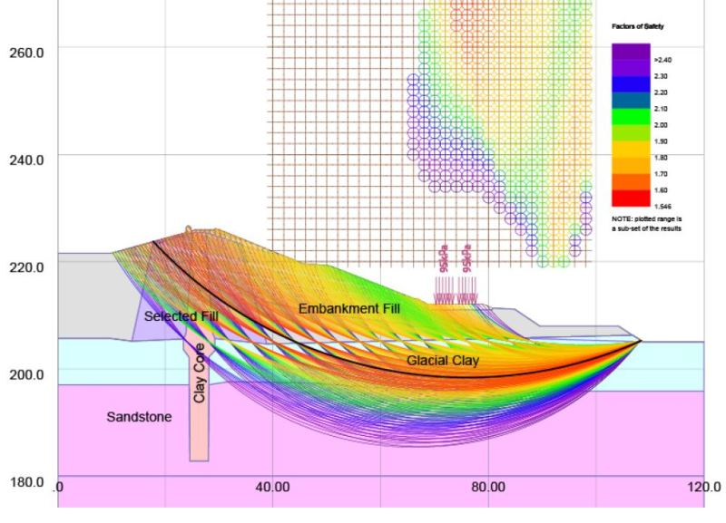
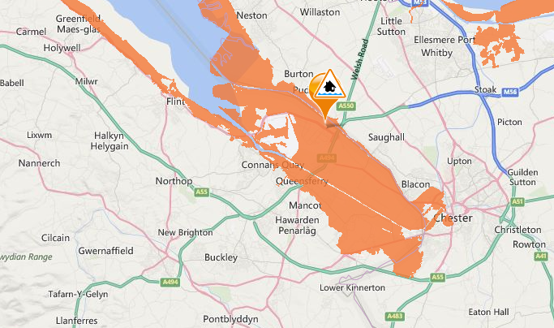
PhD Proposal
Model Deepwater and near shore coastal storm conditions of target locality
Construct detailed geotechnical model of target locality structure and relevant surroundings.
Couple of the above to form hydro-geotechnical.
Potential use of geotechnical Remote Condition Monitoring (RCM) sensors of target locality earthwork.
-Measurement of inclination, temperature, porewater pressure.
Objectives
Create probabilistic flood risk and geotechnical instability maps in respect to initial storm event and from long term inundation and duration.
Allow more effective allocation of resources in preparation and recovery from inundation event. Overall, reducing repair and long term maintenance costs.

Slide 5
Dependencies
Network Rail
Appropriate study site (Ideally, N.Wales).
Borehole logs and geotechnical/soil mechanical properties of site.
Sensor acquisition, installation and operational costs.
Opportunity
Network Rail Welsh route in partnership with JBA regarding coastal asset management plan. PhD natural evolution of this.
Challenge
Coupling of historical oceanographic data to damaging geotechnical events.
Extrapolating these events to accommodate future sea-level and change in the nearshore conditions which will be experienced.

Slide 6
Any questions?

