Slide 1
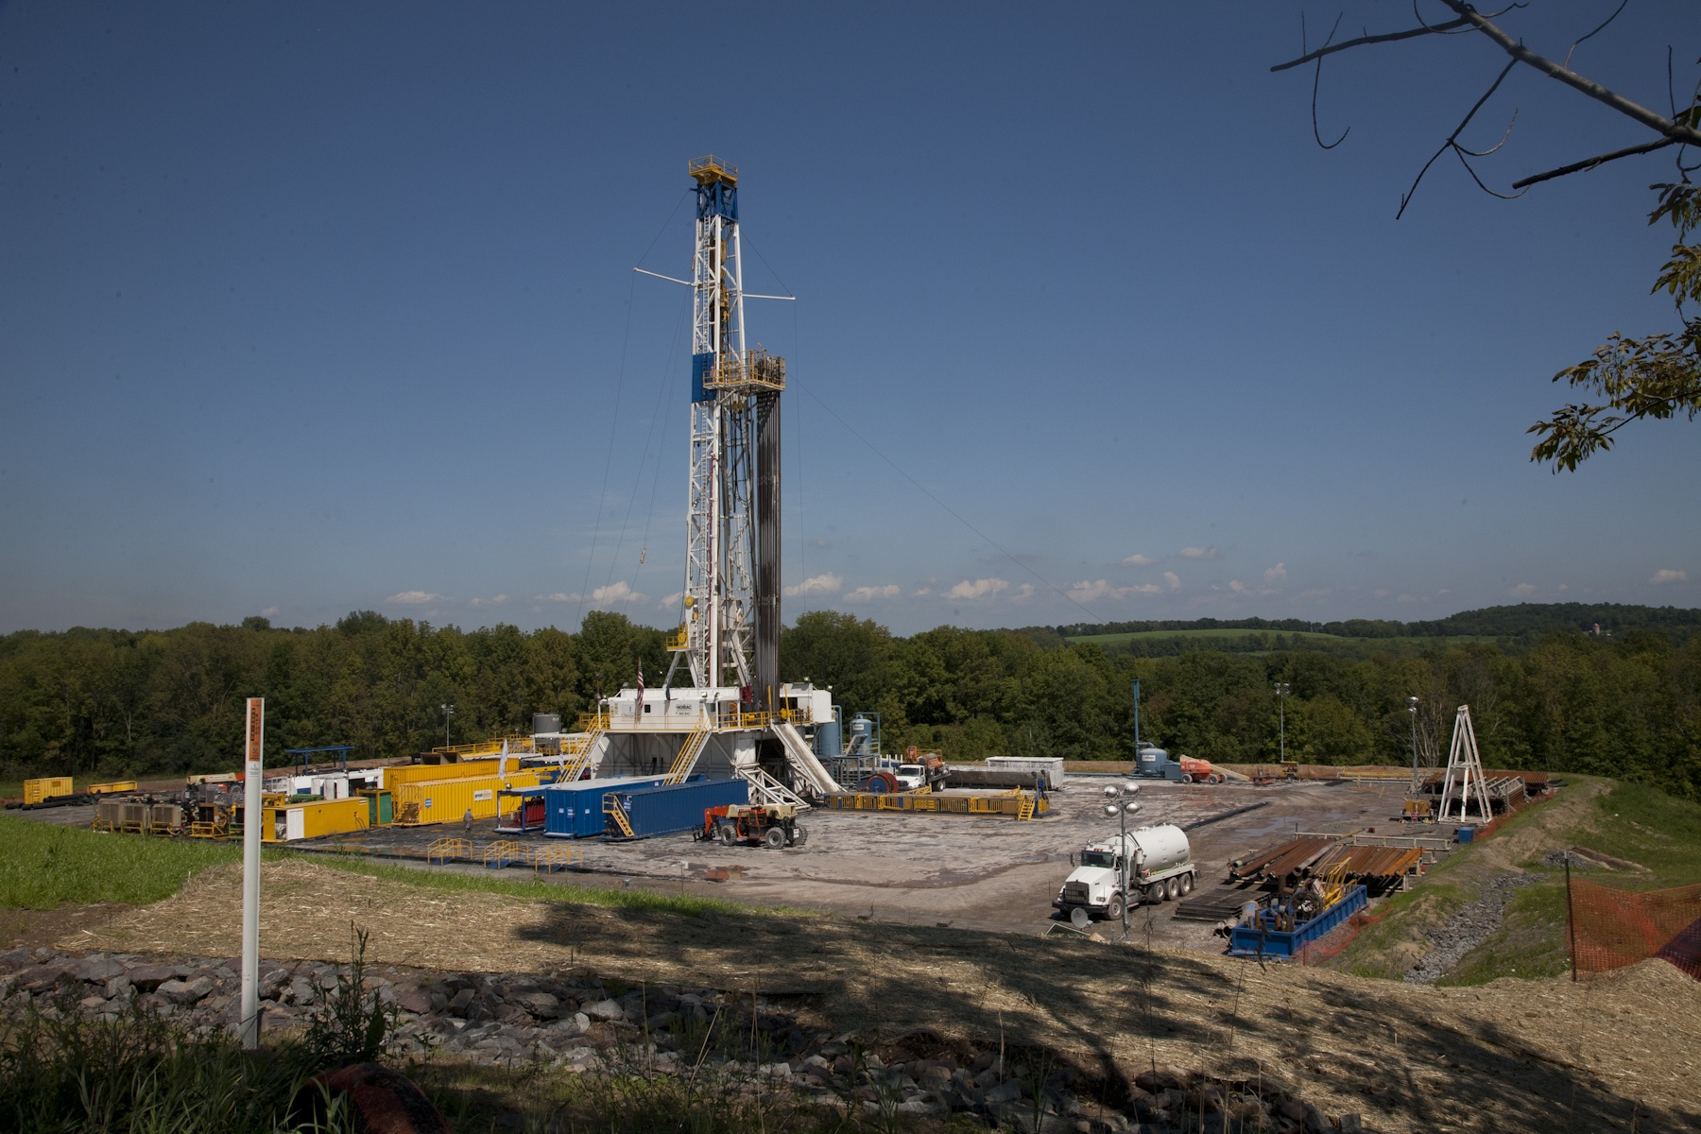
A probabilistic modelling approach to assessing the risks to groundwater contamination from hydraulic fracturing for a UK shale gas industry
Olivia Milton-Thompson

Slide 2


Contaminant transport pathway
Conventional abandoned oil well
a
Unconventional oil well
b
Permeable Rock
a
Well integrity failure
Chalk Aquifer
a
b
Infiltration
Impermeable Rock
c
Fracture propagation
c
d
Natural fracture connection
e
d
Shale
e
Connection with old oil well
www.wisecdt.org

Slide 3
Well Integrity
Casing
Cement
Formation
SOURCE
Hydrocarbon reservoir
Permeable formations
Coal seams
Biogenic/thermogenic gases
A
D
B
C
PATHWAYS
A Through fractures in the cement
B Between cement and casing
C Through the cement
D Between cement and formation
E Through gaps in the cement
E
RECEPTOR
Groundwater
www.wisecdt.org

Slide 4
Code Violations
Highlighted all code violations linked to well integrity from the Pennsylvania database between 2009-2014
Code | Description
78.73A, 78.73B, 78.81D1 | Improper pressure control
78.82, 78.83GRNDWTR, 78.84, 78.86* | Improper casing to protect fresh groundwater
78.81D2, 78.83A, 78.83(c), 78.83COALCSG, 79.12CW | Improper casing and cementing procedures
78.81(a)2, 78.81(a)3, 207B, OGA 3217(B) | Improper casing and cement to prevent migration to fresh groundwater
78.85 | Improper cement installation
78.91(a), 210INADPLUG, 210NCPLUG | Inadequate or leaking plug to prevent vertical flow
3.8% are violations (16,041 wells drilled)
www.wisecdt.org

Slide 5
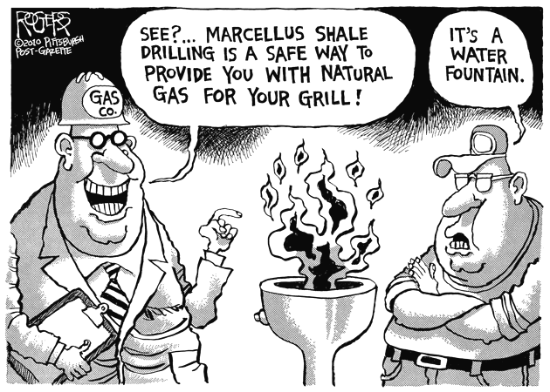
Current and Future Work
Improve the data:
A more accurate search is needed to find all violations – needs to include key words from the comments section.
To analyse the data from 2015 to current (violation codes changed).
Create the model:
Develop a simple numerical model to quantify well violations to produce the probability distribution function.
Write the report:
Produce a report/paper on the development of Features, Events and Processes from hydraulic fracturing.
www.wisecdt.org

