Slide 1
What’s Joe been up to…?
with Professor Roger Falconer &
Dr Reza Ahmadian

Slide 2
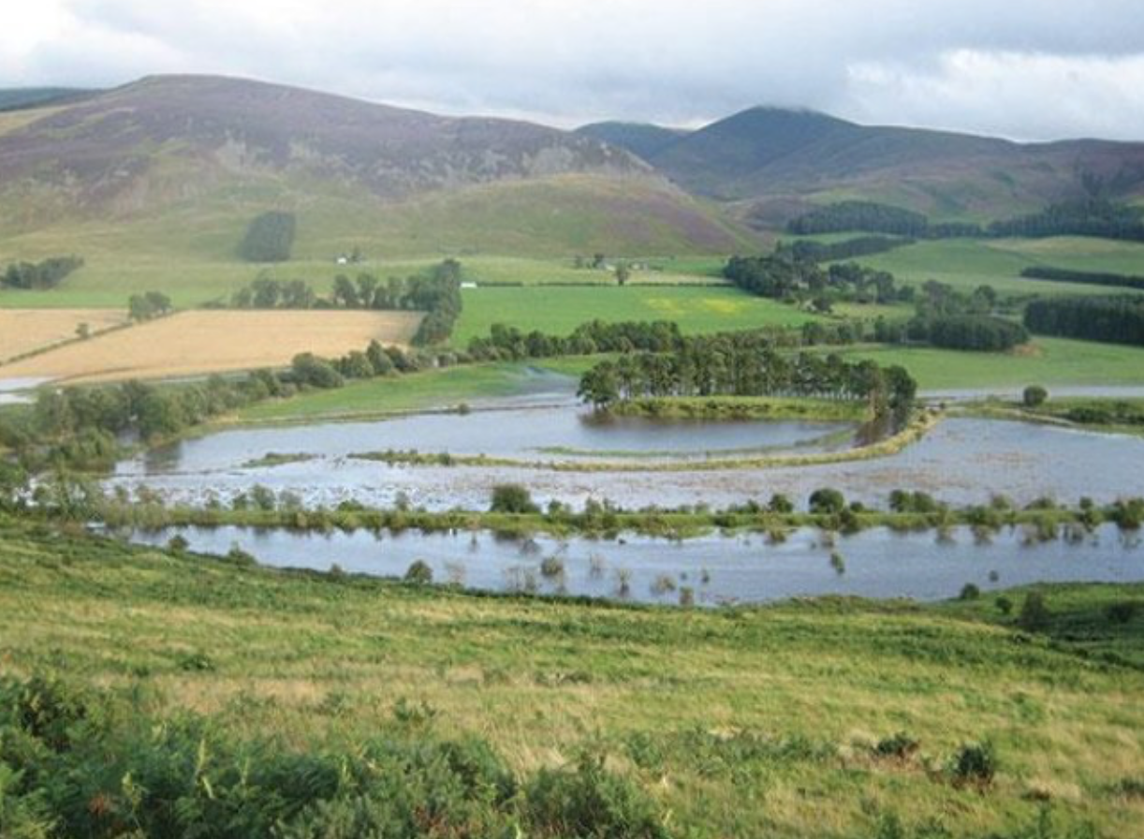
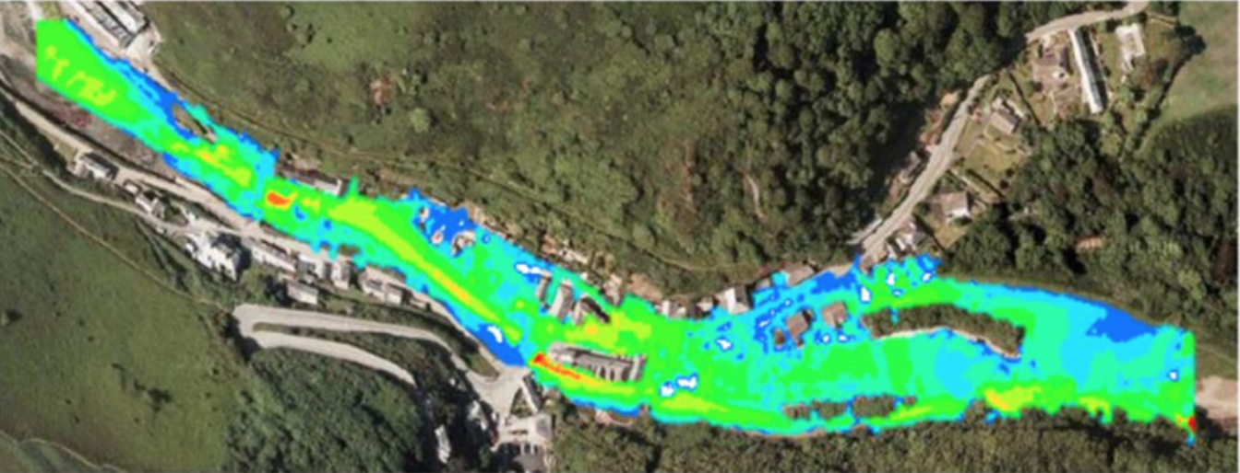
So, where did I start?
Interested in:
  Natural Flood Management (NFM)
  Computational Modelling
(Kvocka, D. 2016)
Notes:
To create a river catchment where water management is fully integrated into land management practices. Where public bodies, private companies and local communities work together to manage water within the landscape, creating valuable habitat for wildlife and people, and limiting flood risk downstream.

Slide 3
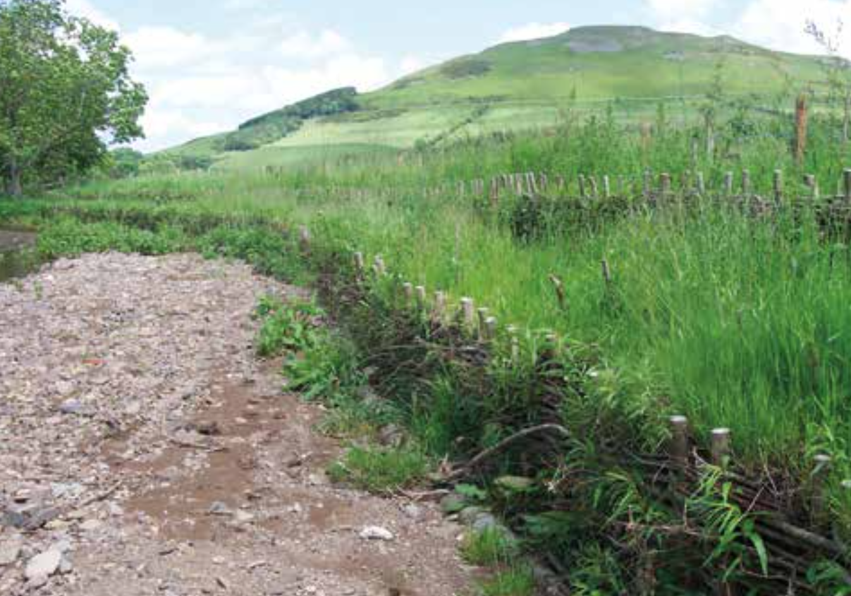
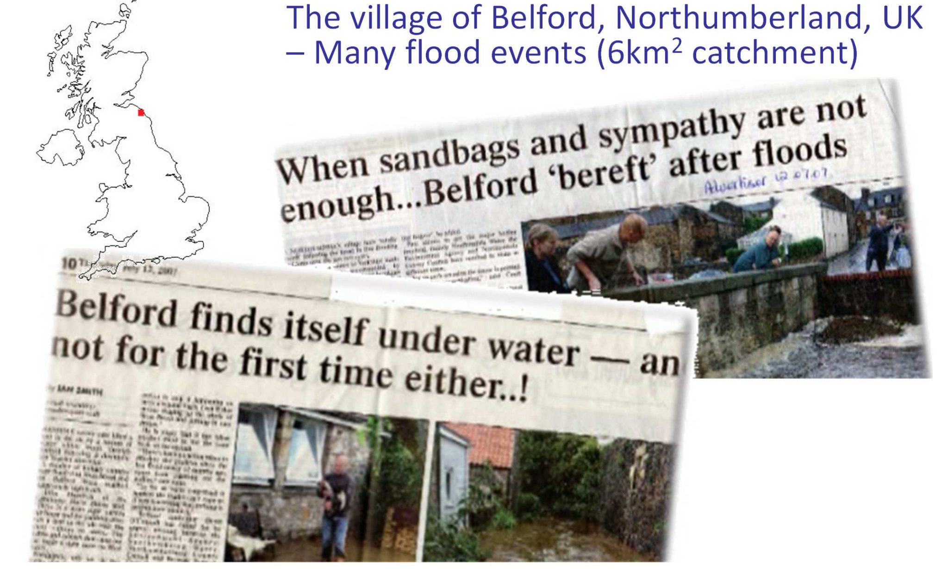
NFM in the UK
Typical situations:
  Previous land management has enhanced flood risk
  Steep sloped
  Areas prone to ‘flash flooding’
  Cost/ benefit analysis show ‘hard engineered’ solutions not viable
Notes:
Previous land management practices in the catchment are considered to have enhanced the risk of Pickering being flooded by promoting rapid runoff and increasing the delivery of sediment and siltation within Pickering Beck.
There are four principal land uses in the 66 km² catchment, comprising:
Arable crops
Improved grassland
Heather moorland
Forestry and woodland
Natural Flood Management project working to reduce flood risk and restore biodiversity throughout the catchment of the River Frome and all its tributaries, including the (Slad Brook, Painswick Stream, Nailsworth Stream, Ruscombe Brook and all their named and unnamed tributaries).
Eddlestone – 69km^2 – scotland – steep in parts
Belford – 6km^2 – 2 mill not worth it. Also steep – flashy floods

Slide 4
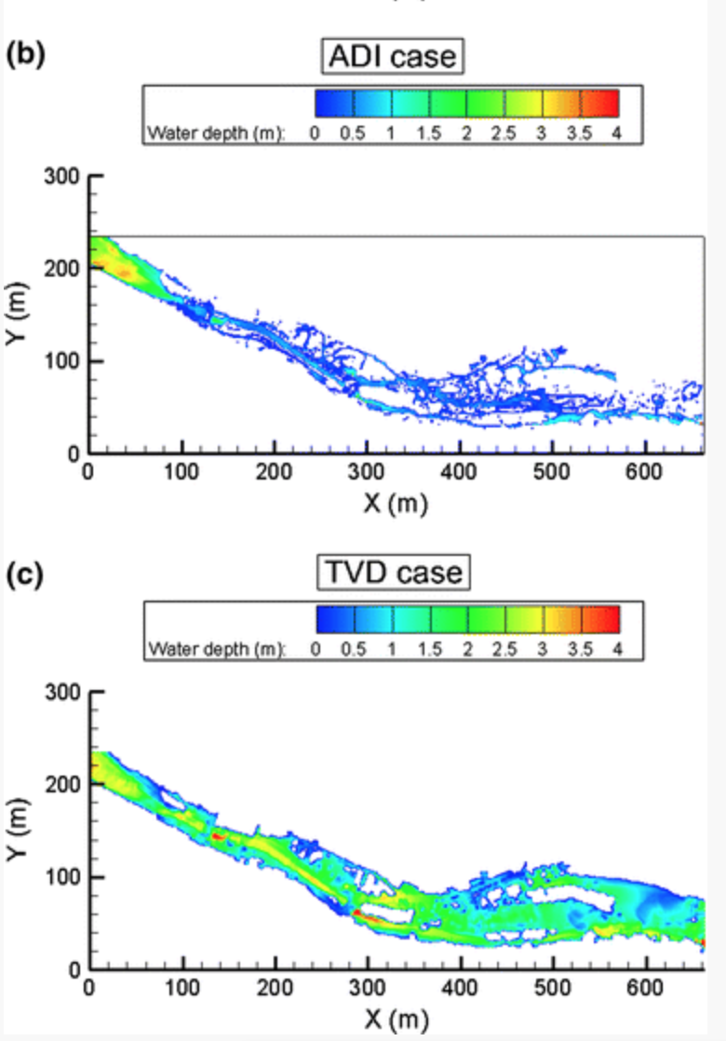
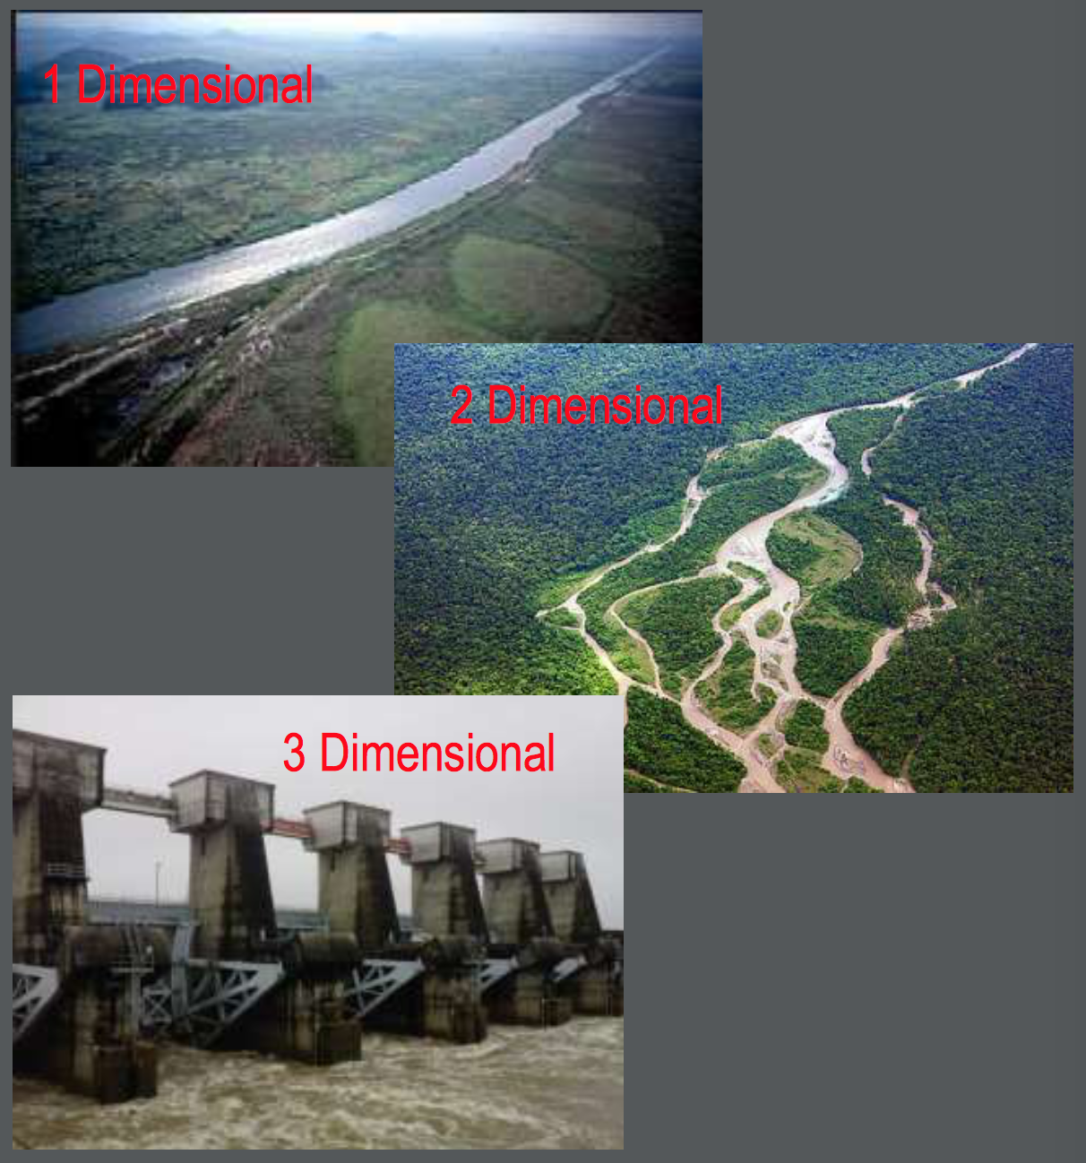
What is the reasoning to my modelling approach?
Previous work has shown:
  Under prediction of peak water levels can occur in short, steep catchments
  Different models are required for different situations
(Kvocka, D. 2016)
Notes:
it is shown to be necessary to incorporate shock-capturing algorithms in the solution procedure, since these algorithms prevent the formation of spurious oscillations and provide a more realistic simulation of the flood levels.
. This difference between the computer-predicted flood characteristics and the actual properties is often a consequence of what is called a “simplification strategy”. In an effort to minimise simulation time and optimise limited resources, it is common practice among flood risk assessment practitioners to simplify the computational process by leaving out governing terms, such as the advective acceleration or not including shock-capturing features for trans- or supercritical flows. For example, in modelling trans- or supercritical flows, numerical oscillations generally occur in conventional 1D or 2D models and the advection terms are often removed or an artificially high bed resistance or eddy diffusion term is included to dampen out the oscillations (de Almeida et al. 2012); for such conditions, it is not then possible to evaluate how much of the increased dissipation is being used in physically dissipating the energy of the flow and how much is being used in numerically damping out the oscillations. Such flood simulation results in potential extreme flood events can lead to time-consuming analysis or an increase in the complexity of the problem that practitioners are dealing with (Leskens et al. 2014). This “simplification strategy” can lead to misleading and incorrect predictions of flood elevations, inundation extent and hazard risk, particularly in urban settings where the impact of a flash flood is higher than in a rural setting where the population is much less and hence the infrastructure is less changed.
1 Dimensional Model
o Steady or Unsteady Riverine Systems o FlowPrimarilyOneDirection
o MinimalSplitFlow
▪ 2 Dimensional Model
o ShallowFloodplainFlow
o Braided or Split Flow Conditions
o MinimalDepthVariedVelocity(SandBars, River Bends, etc)
▪ 3 Dimensional Model
o ComplexRiverineSystems o FlowAroundStructures
o DepthVariedVelocities

Slide 5
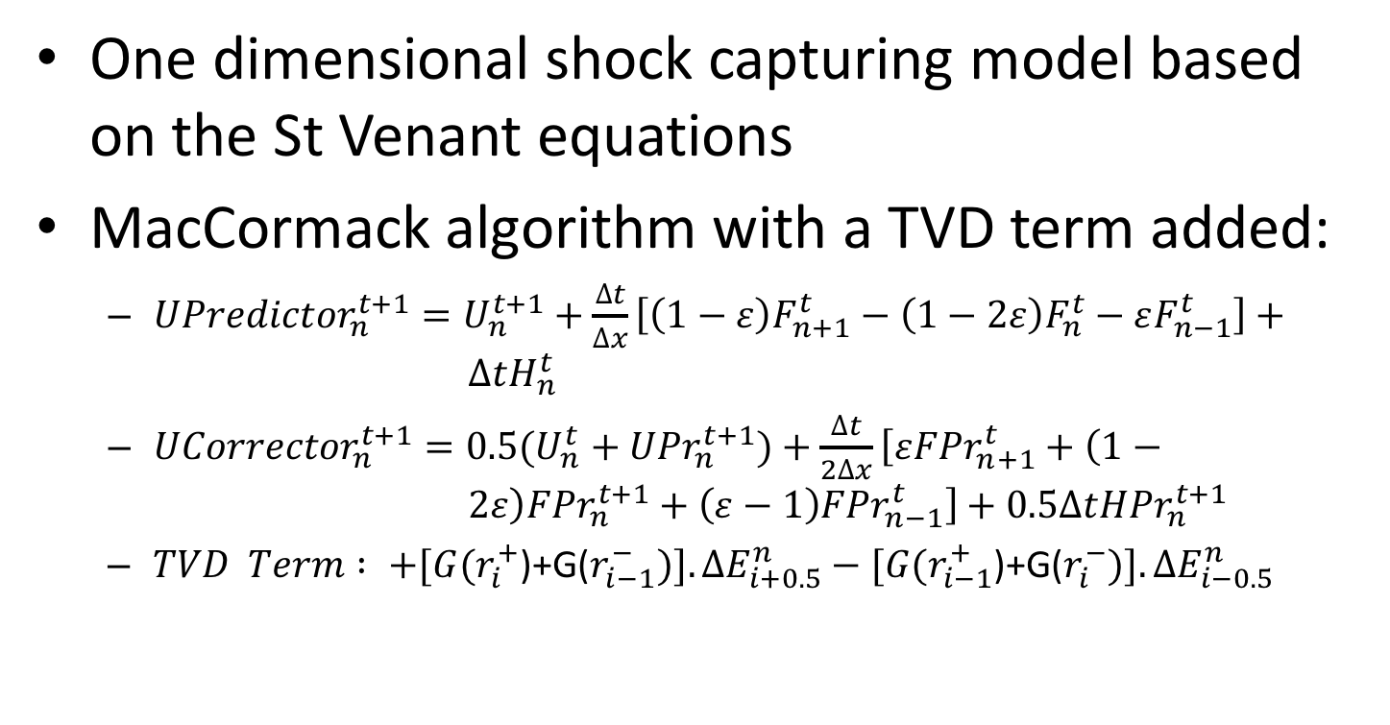
So, what is my model?
One dimensional shock capturing model based on the St Venant equations
MacCormack algorithm with a TVD term added:
  ${UPredictor}_{n}^{t+1}=U_{n}^{t+1}+\frac{∆t}{∆x}\left[\left(1−ε\right)F_{n+1}^{t}−\left(1−2ε\right)F_{n}^{t}−εF_{n−1}^{t}\right]+ ∆tH_{n}^{t}$
  ${UCorrector}_{n}^{t+1}={0.5(U}_{n}^{t}+{UPr}_{n}^{t+1})+\frac{∆t}{2∆x}\left[ε{FPr}_{n+1}^{t}+\left(1− 2ε\right){FPr}_{n}^{t+1}+\left(ε−1\right){FPr}_{n−1}^{t}\right]+0.5∆t{HPr}_{n}^{t+1}$
  $TVD Term : +[G(r_{i}^{+}$)+G($r_{i−1}^{−})].∆E_{i+0.5}^{n}−[G(r_{i−1}^{+}$)+G($r_{i}^{−})].∆E_{i−0.5}^{n}$
(Garcia – Navarro, P. 1992)

Slide 6
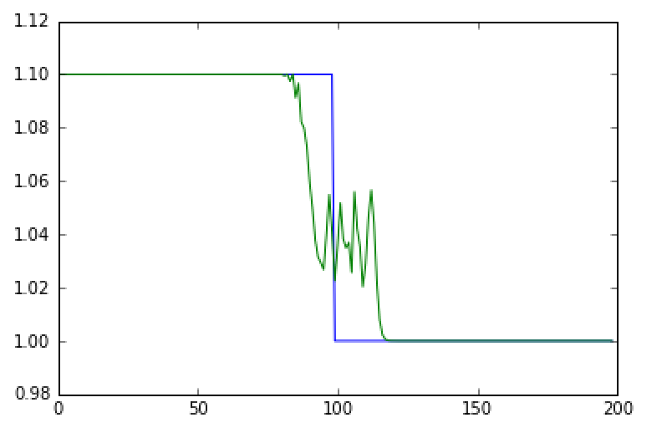
Any results?
Initial results are being calibrated against numerical results from literature
This case is a dam break scenario, which is useful in validating shock capturing models

Slide 7
What’s next
Finish calibrating model against numerical and experimental results
Apply to case studies which include Natural Flood Management … open to collaboration!

