Slide 1
Beach Erosion and Recovery
Student: Gwyn Hennessey
Supervisor: Dr Chris Blenkinsopp
Bath University

Slide 2



Contents
1. Introduction
2. Aims and Objectives
3. Narrabeen Beach
4. What is Lidar?
5. Methodology

Slide 3
Introduction
1. Extreme storms serve as a reminder of the dangers faced by people, the natural environment and infrastructure in coastal areas.
2. Beaches are natures coastal protection.
3. Beaches accrete in calm wave conditions and erode in large wave storm conditions.
4. A major focus of current research is to develop and improve numerical modelling tools that can be used to undertake this assessment.
5. Development of such models has been hampered by a lack of field data which quantifies morphology change on the timescales of storms and recovery.
6. The lack of high quality suitable data is due to the very significant practical difficulties involved in making accurate, rapid and repeat beach profile measurements
Notes:
1. Climate Change effects.
2. providing a buffer zone which protects the coastal areas from extreme waves and water levels.
3. Beaches are highly complex, dynamic systems, experiencing changes on a variety of temporal and spatial scales. In some case the sand volumes can take considerable time to return, which results of this leading to a prolonged period of vulnerability
4. A fundamental challenge for Coastal Scientists & Engineers is to determine whether existing sand volumes are adequate to protect coastal areas.
5. Before storm events, during storm events and during the slower and much less studied post-storm recovery phase.
6. It is rare that a survey is completed just prior to the onset of a storm.
No field-scale data during storms.
Post-storm surveys are commonly completed weeks and sometimes months after.
Post-storm surveys completed at sufficiently short intervals to investigate beach recovery are unavailable.

Slide 4
Aims and Objectives
1. Obtain beach morphology data capturing both erosion and recovery processes using a building-mounted Lidar system at two differing sites.
2. Gain new insight into the understudied topic of beach recovery including the rate and patterns of morphological changes following storms.
3. Investigate coherent patterns of change across the beach face and the relationship with forcing conditions.
4. Investigate the relationship between surf-zone bars and swash-zone morphology.
5. Comparison of morphology change at two site under similar conditions.
6. Try to determine the existence of a beach face equilibrium condition and the potential for the development of a behavioural model of beach response.

Slide 5
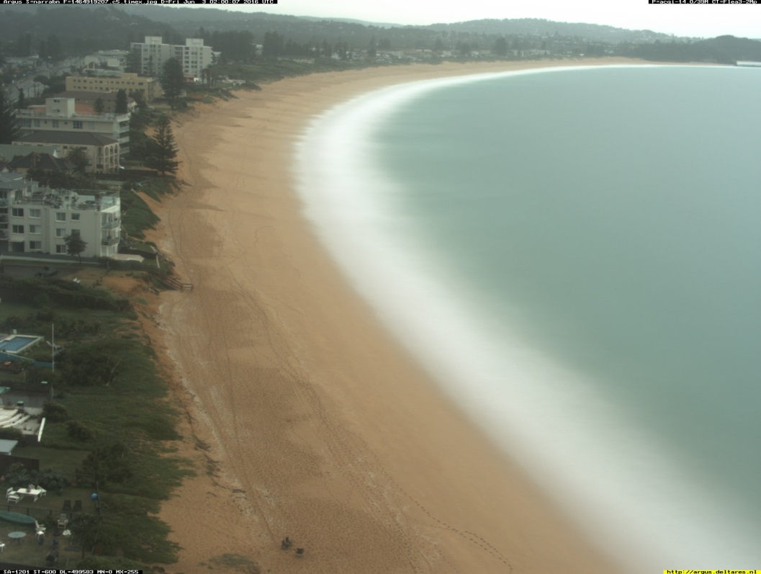
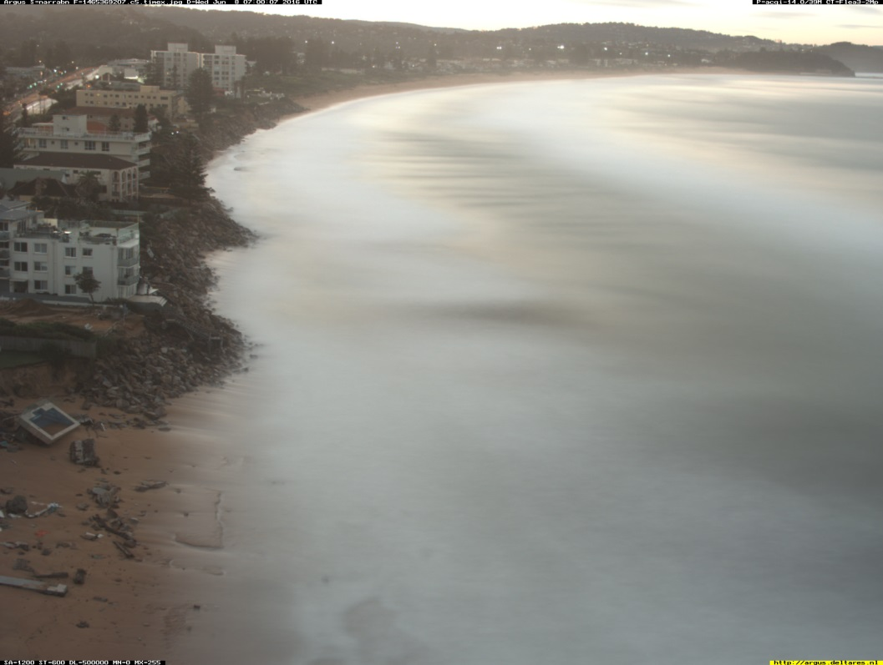
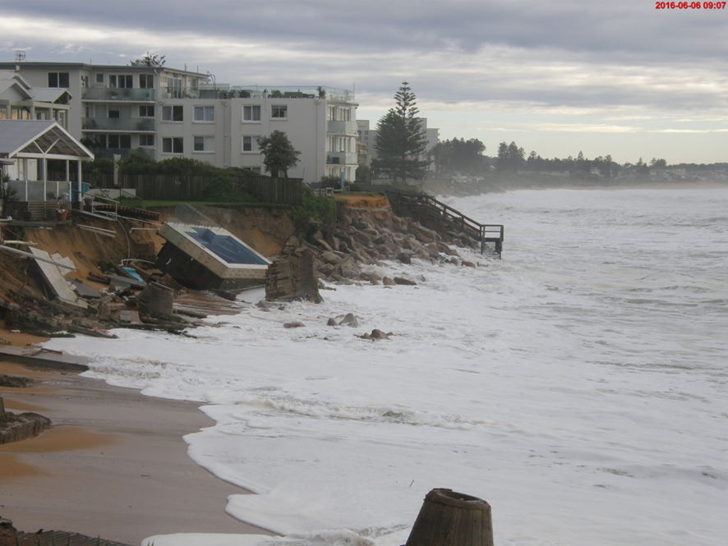
Site 1 - Narrabeen
Observations June 2016 Storm
03/12/2016
08/12/2016

Slide 6
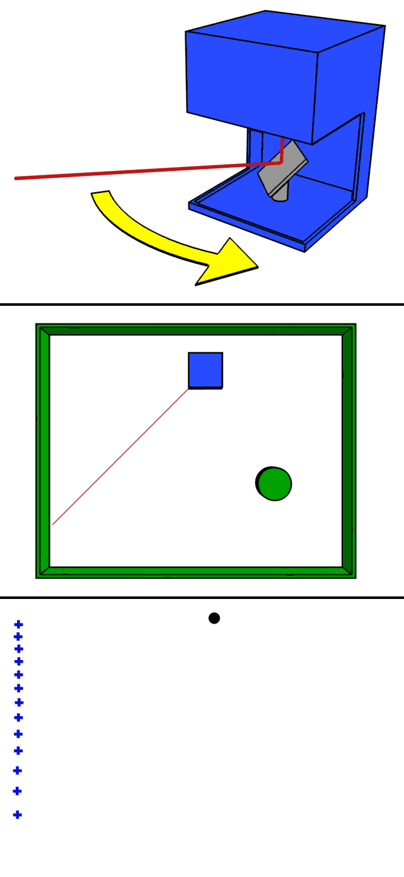

What is Lidar
A surveying method that measures distance to a target by illuminating that target with a pulsed laser.
Measuring the reflected pulses with a sensor.
Differences in laser return times and wavelengths can then be used to make digital 3D-representations of the target.

Slide 7
Methodology
Data
Lidar data will give continuous measurements of beach profile evolution during storm events and post-storm recovery, providing the capability to capture the forcing inshore waves, water-levels, surf zone and swash zone.
Data Analysis
Datasets of high resolution will be analysed using a range of approaches to elucidate new information about complex coastal processes.
Behavioural Model
Attempt the generation of a behavioural based model.
Notes:
Data - The Lidar System will collect details of morphological change for a range of physical conditions.
Data Analyis - Analysis of data in both the time and frequency domain will be required along with multivariate data analysis and development of a behavioural, dynamical systems approach to understanding beach behaviour.
Behavioural Model - Analysed data will hopefully provide a better understanding of how morphology during the erosion and recovery periods changes during and post storm,
This for example could be done using modelling concepts such as Artificial Neural Networks and Bayesian Belief Networks.

Slide 8
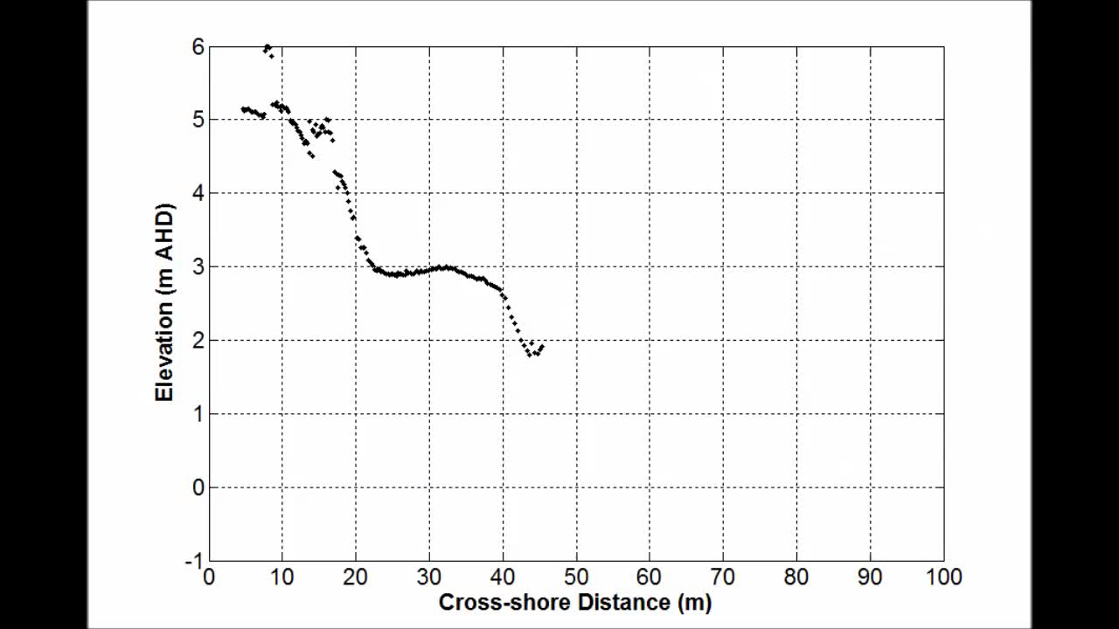
Observations June 2016 Storm – Narrabeen Beach

Slide 9
Observations June 2016 Storm – Narrabeen Beach

Slide 10
Thank you
Any Questions?

