Slide 1
Biosensor development and signal processing for real-time water quality monitoring
WISE PhD proposal
June 2017
Student: Dolores Gonzalez
Supervisors: Mirella Di Lorenzo, Petra Cameron
Chem. Eng. Dept., University of Bath

Slide 2
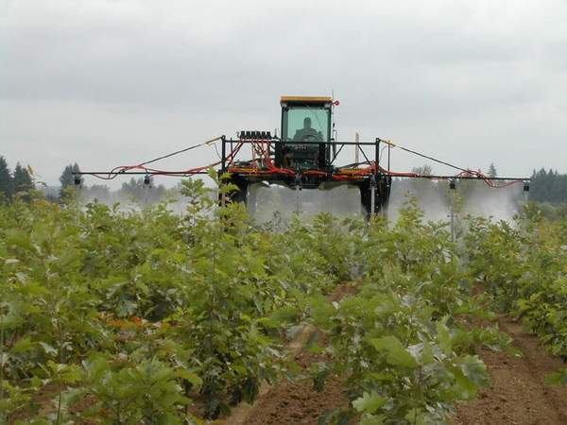
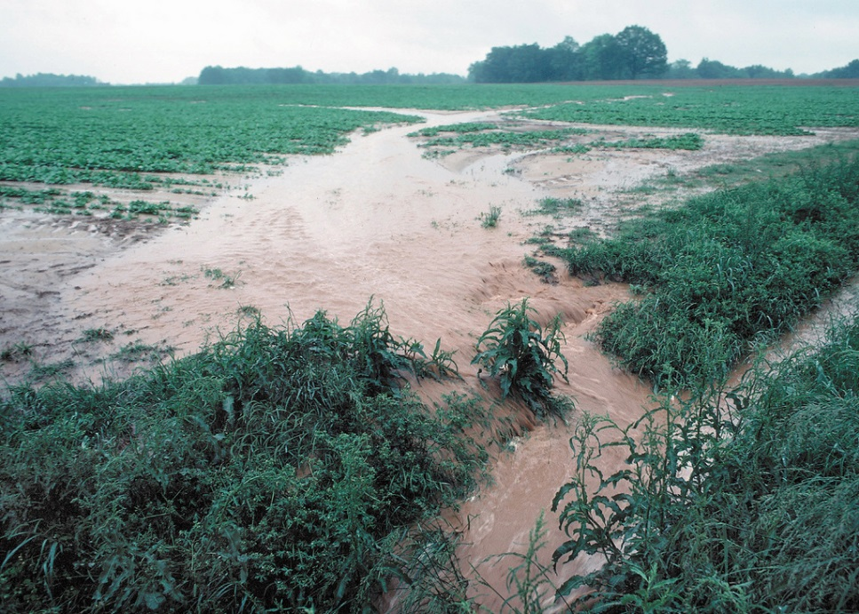
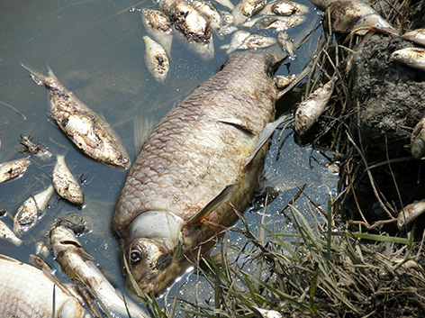
Problem statement
Runoff of pollutants
Bio-toxicity
List of priority substances by the Water Framework Directive
There is a need to develop an online, continuous and real time sensors for water quality monitoring.
www.wisecdt.org

Slide 3
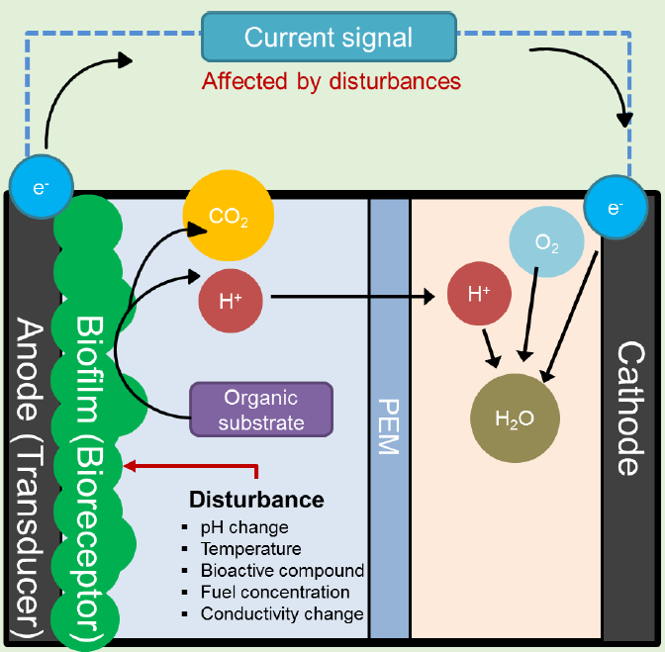
Microbial Fuel Cell (MFC) Biosensor principles
Advantages
Low cost
Portable
Wide range of contaminants
Challenges
Reproducibility
Selectivity
Response time
Signal processing
www.wisecdt.org

Slide 4
Research aim
The aim of this project is to improve the knowledge in signal processing of MFC biosensors to promote practical applications.
Project objectives
To design a continuous and real-time MFC biosensor.
To prove the ability of the sensor to detect components of interest.
To develop a model to interpret and predict the sensor’s output.
To validate the sensor in the field.
www.wisecdt.org

Slide 5
Previous data
Literature review
MFC sensor
Data generation
Model screening
Model calibration and
validation
Model selection for prediction and interpretation
www.wisecdt.org

Slide 6
Thank you for your attention.
Questions or comments?

