Slide 1
Assessing the resilience of water systems exposed to multiple hazards
Anna Lo Jacomo
University of Bristol
Supervisors: Prof. Dawei Han, Prof. Alan Champneys
Notes:
-Evaluate how resilient different water systems are in cities exposed to multiple hazards

Slide 2
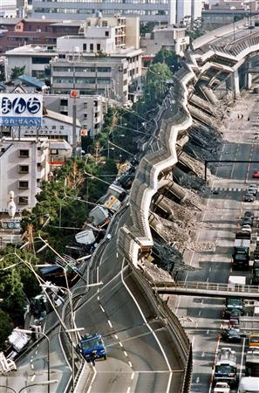
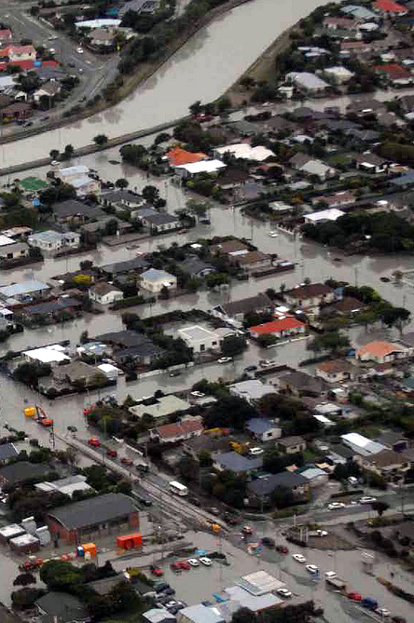
Some cities cope with disaster better than others
Kobe earthquake
(Japan)
1995
Magnitude 7.2 M_{w}
Christchurch
Earthquake
(New Zealand)
2011
Magnitude 6.3 M_{w}
www.wisecdt.org
Notes:
-More than half of the world population now lives in cities
-Advantages: lower carbon emissions
-Disadvantages: rely on interconnected systems which are vulnerable to natural hazards
-We need better tools to assess and improve the resilience of urban infrastructure
-We focus on the water infrastructure

Slide 3
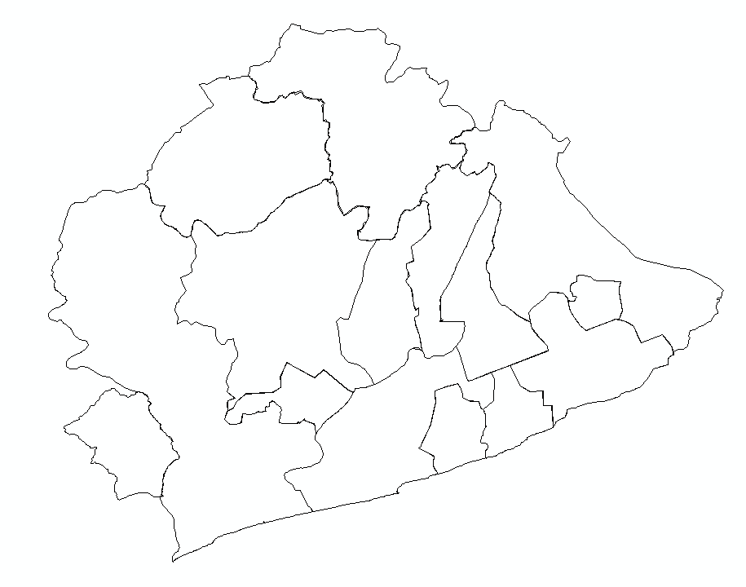

We are using an integrated systems approach to model the water infrastructure
Waste
water
CO₂
Fresh water
Technologies
Objectives
Wastewater treatment
Optimisation
Electricity
B
Water and wastewater requirements
A
A
A
…
www.wisecdt.org
Notes:
-Reviewed methods
-Integrated systems approach
-Based on prototype model called resilience.io
-Flexible and scalable
-Can model a range of technologies by specifying inputs and outputs
-Examples of water system technologies modelled are
borehole water supply,
source water treatment
bottled water for supply
aerated lagoons
decentralised aerobic plants for treatment
-Optimises the distribution of these technologies
-According to objectives of cost and emissions
-To meet requirements

Slide 4
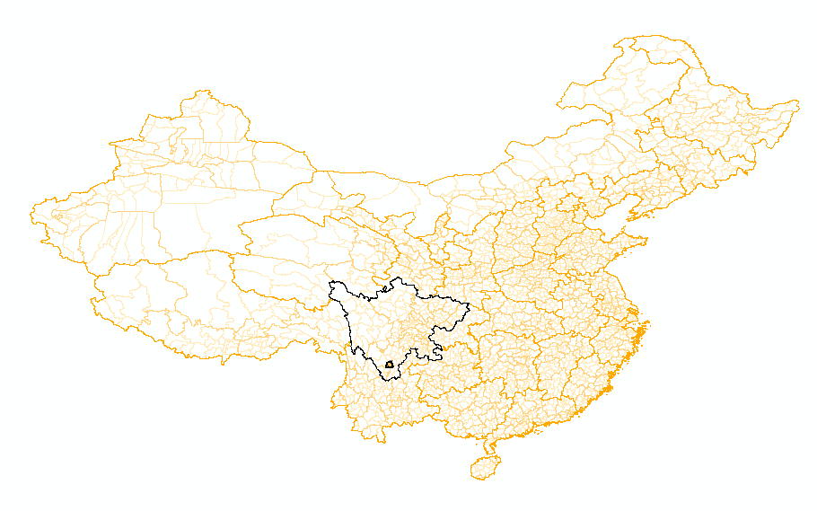
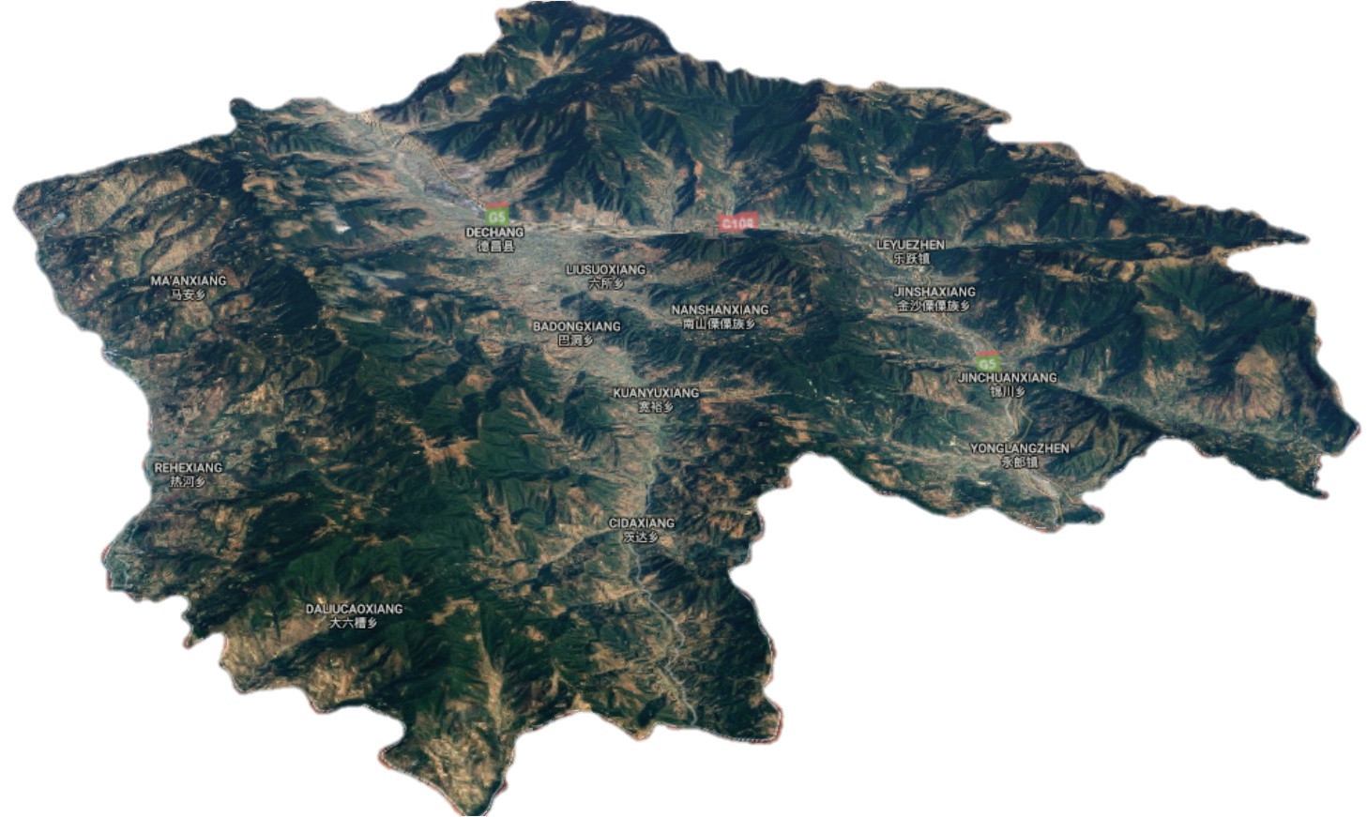
We are focusing on a case study site in China which is at risk from multiple hazards
Sichuan
province
Dechang
2000 km²
200,000 inhabitants
www.wisecdt.org
Notes:
-Called Dechang
-Sichuan province
-Small city region
-Mountaineous area
-Average annual rainfall is 1000 mm
-Experiences earthquakes, landslides, floods

Slide 5

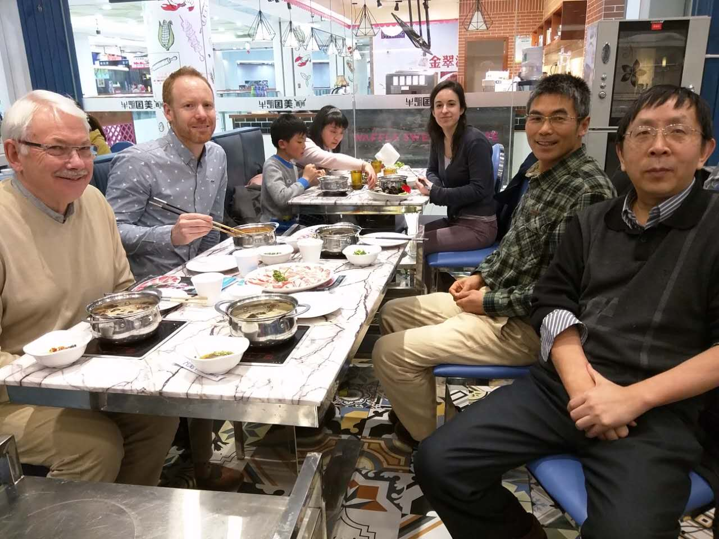



We are working with collaborators as part of the RESIST project
Landslide and earthquake data
Flood information
Lu Zhuo
Model prototype
www.wisecdt.org
Notes:
-Collaboration between the UK and China
-Mountain institute
-Researchers at UoB
-Provide rainfall and flood inundation extents
-EST provided prototype of the model

Slide 6
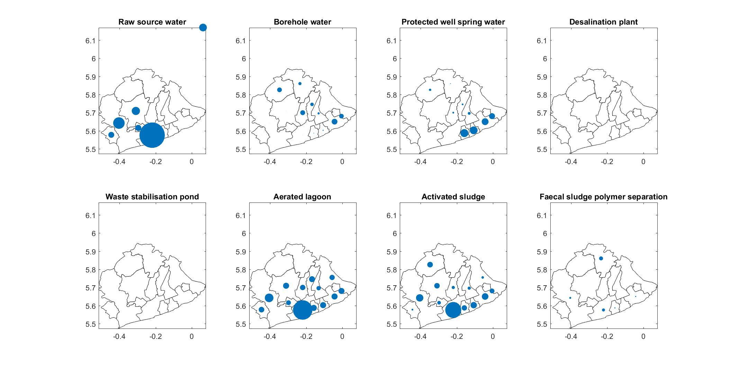
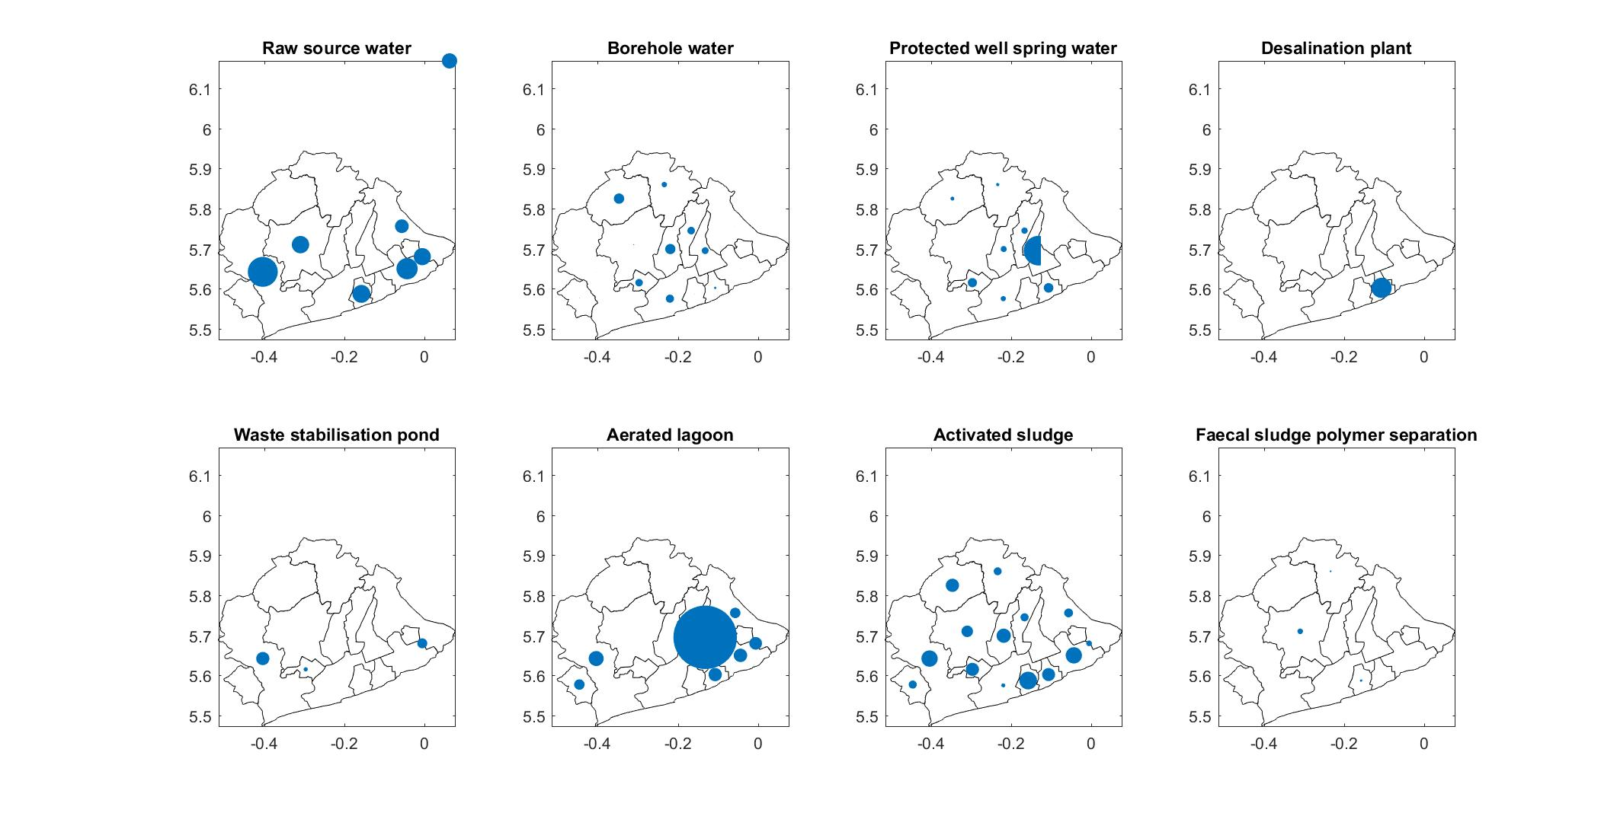
We adapted the model to incorporate flood risk into the objectives
No flood
Flooded
Aerated lagoon
allocation
Activated sludge allocation
Number of technologies allocated
www.wisecdt.org
Notes:
-Example of model outputs
-Size of blue dots is number of technologies allocated
-We show aerated lagoon and activated sludge treatment as a sample
-This model run was allocating eight different technologies
-Under no flood scenario it allocates most of the capacity where demand is greatest
-Under flood scenario it diverts capacity to the next most beneficial area
-Taking into account other technologies, cost, and emissions

Slide 7
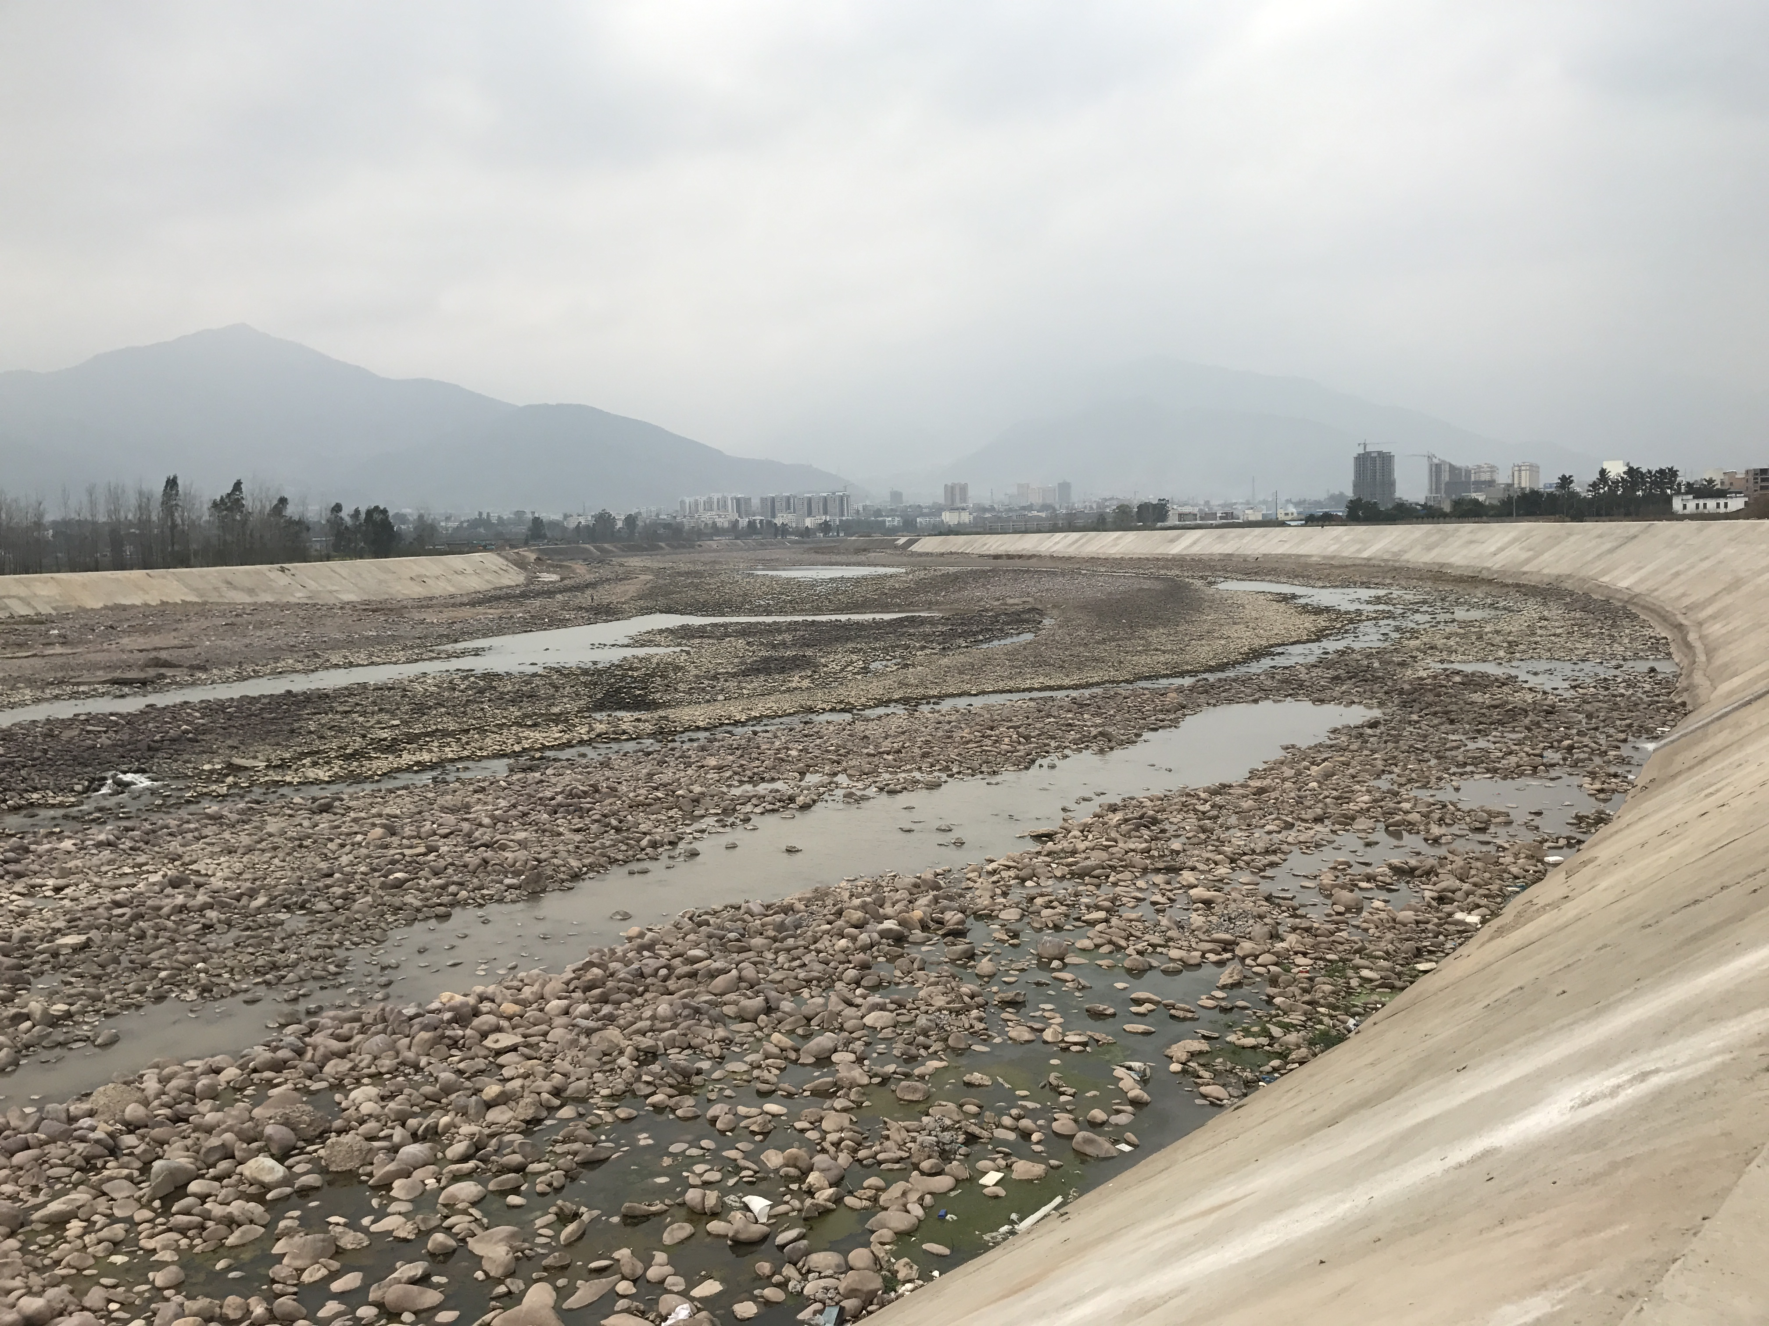
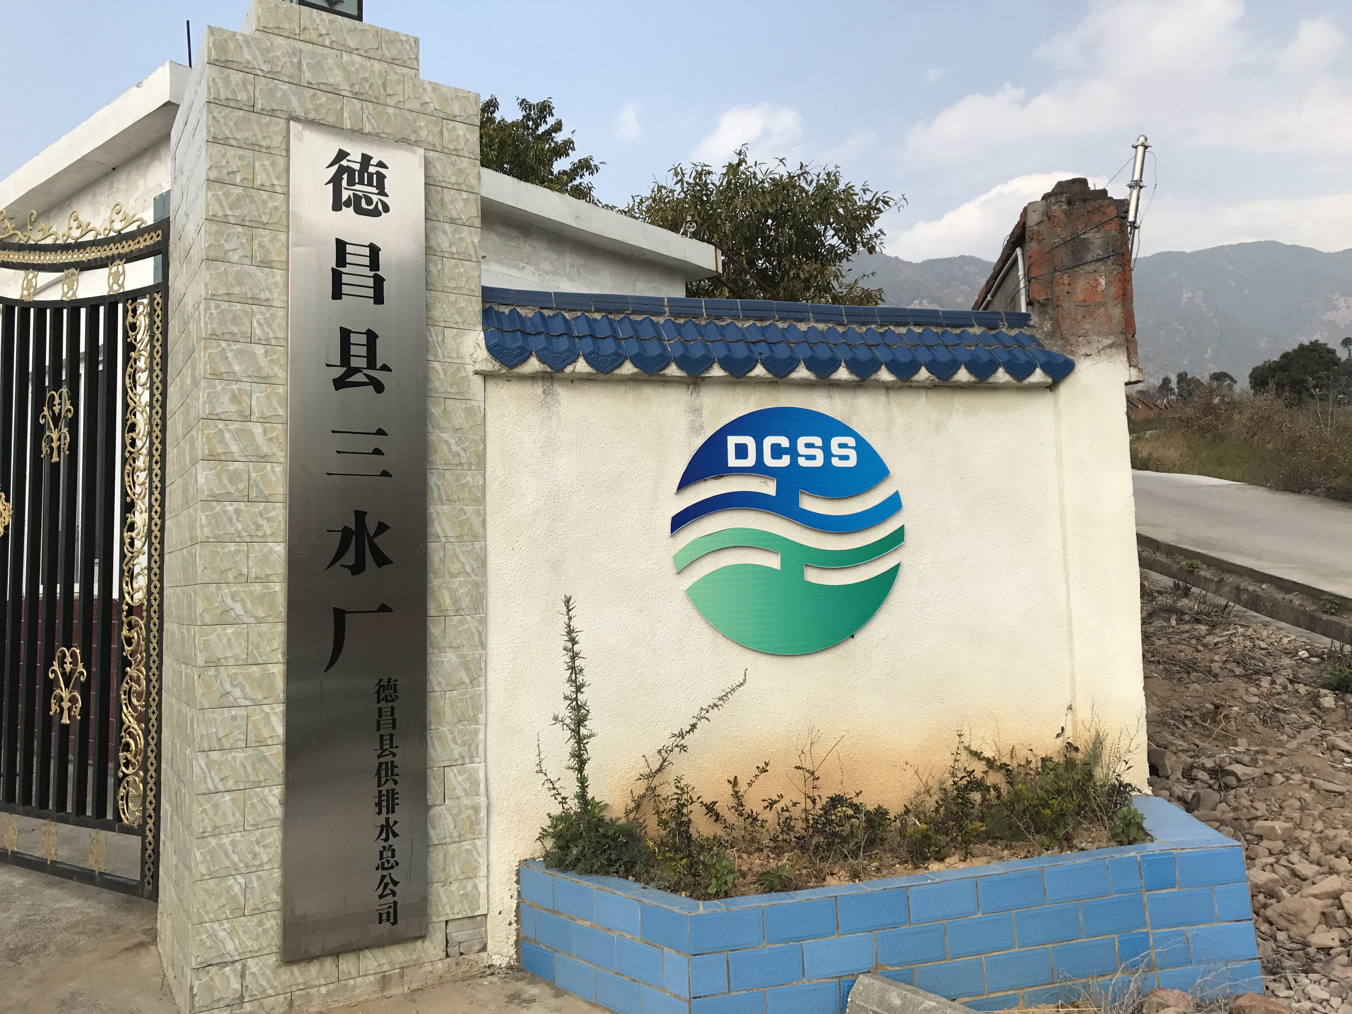
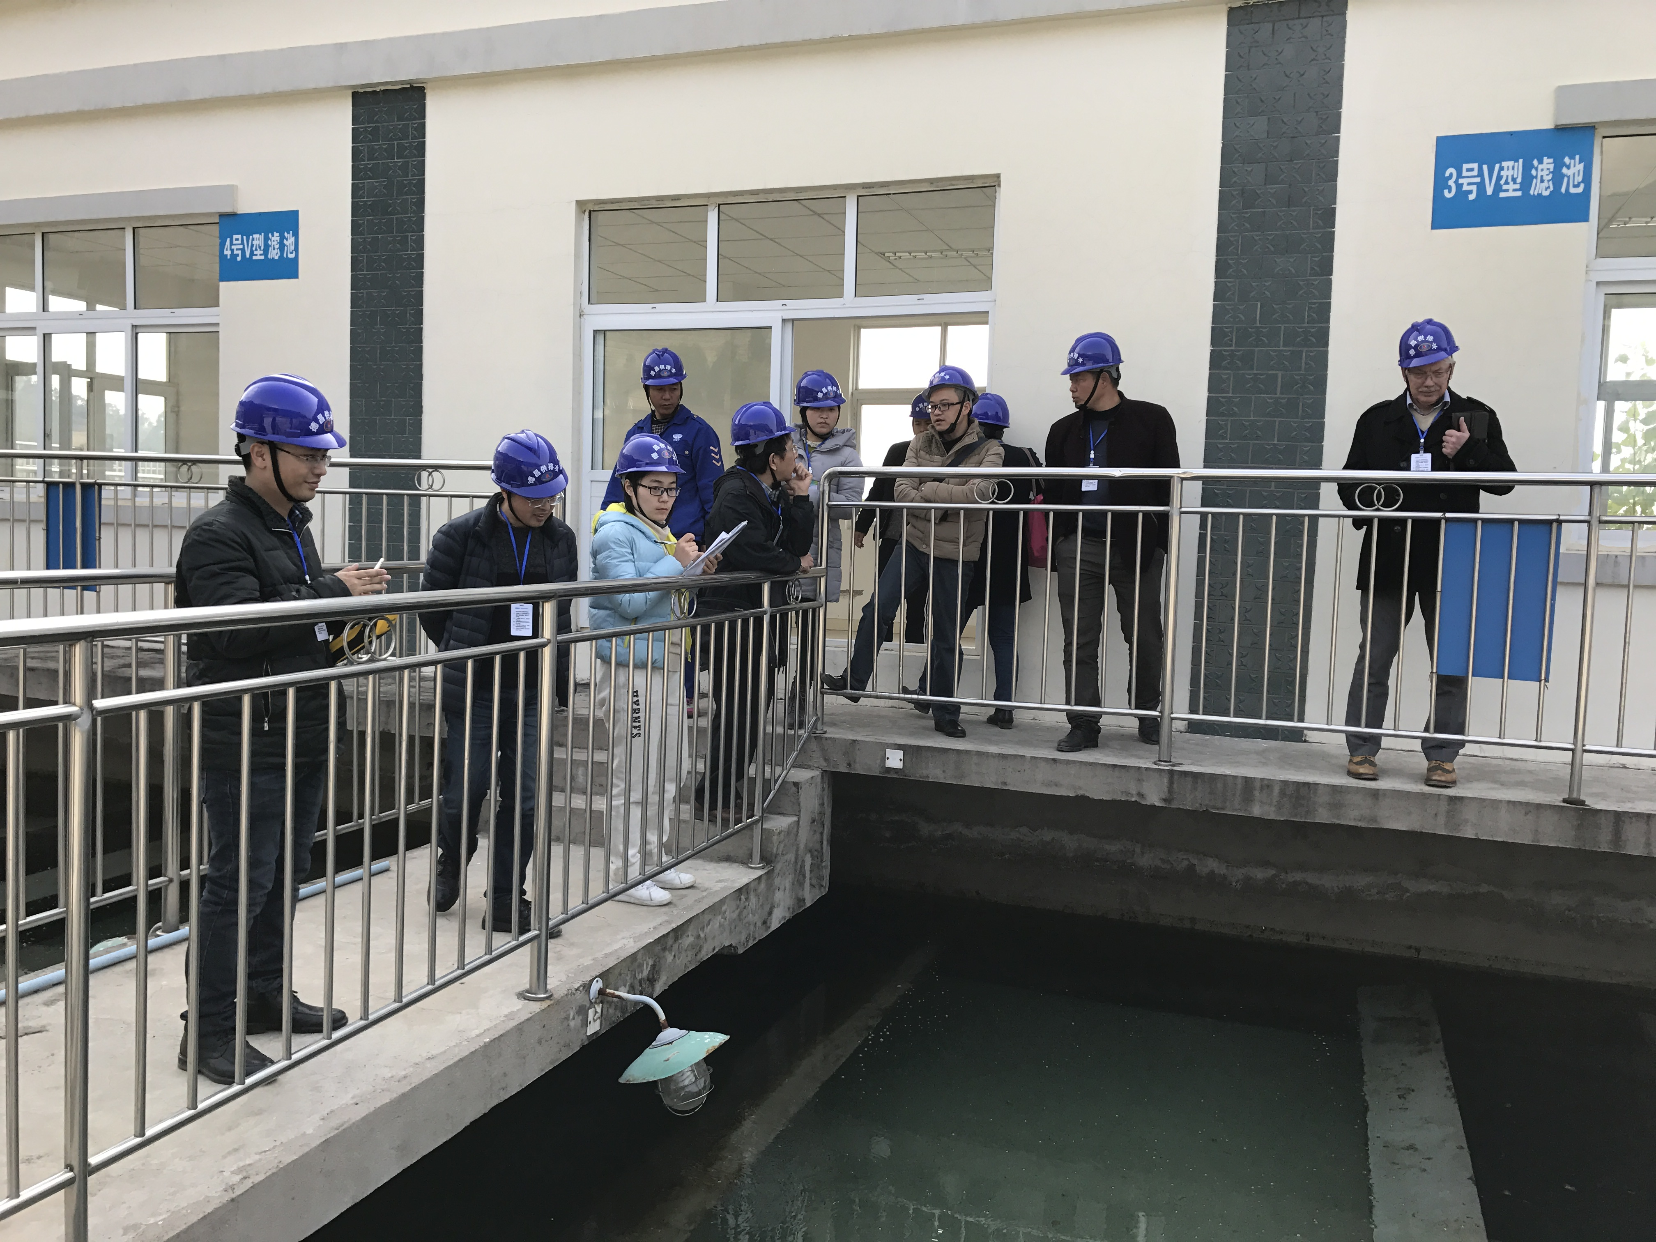
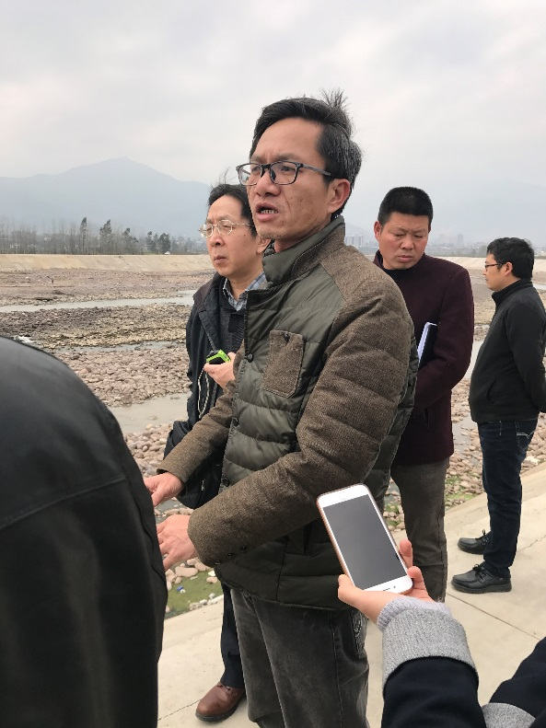
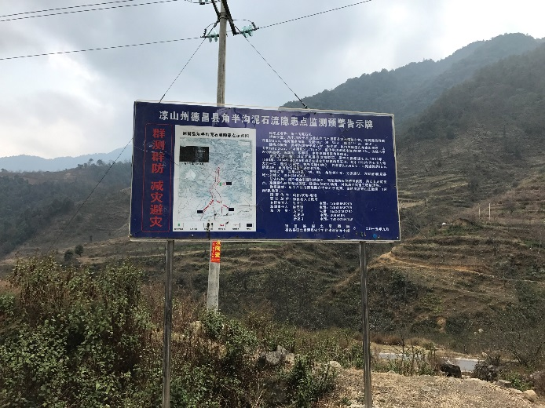
We conducted a site visit to learn about the infrastructure at the case study site
www.wisecdt.org
Notes:
-We visited Dechang, the study area
-Gathered information on the water treatment plants
-The flood and landslide defences
-Spoke to the local authorities
-Interest in trialling an integrated systems tool for managing hazards in the area

Slide 8



The next step will be to adapt the model to include impacts from multiple hazards
www.wisecdt.org
Notes:
-Model the impacts of floods, landslides and earthquakes
-Including different effects on different technologies
-Understand what changes to the current water system could improve the resilience to hazards

Slide 9
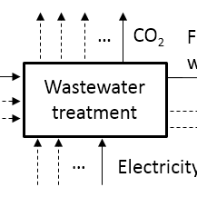
Thank you!
www.wisecdt.org

