Slide 1
Understanding Polyphosphate for improved HRAP operation
Aidan Barry
University of Bath

Slide 2
A Green solution
Algal blooms/eutrophication caused by excess nutrient release from STP’s
Current technology uses chemical processes to remove P- exponentially expensive
Alternatives- Struvite, EBPR
Why algae? No chemicals, low input, recoverable phosphorus
Why not algae? Large footprint, wrong goal
Want to improve viability

Slide 3
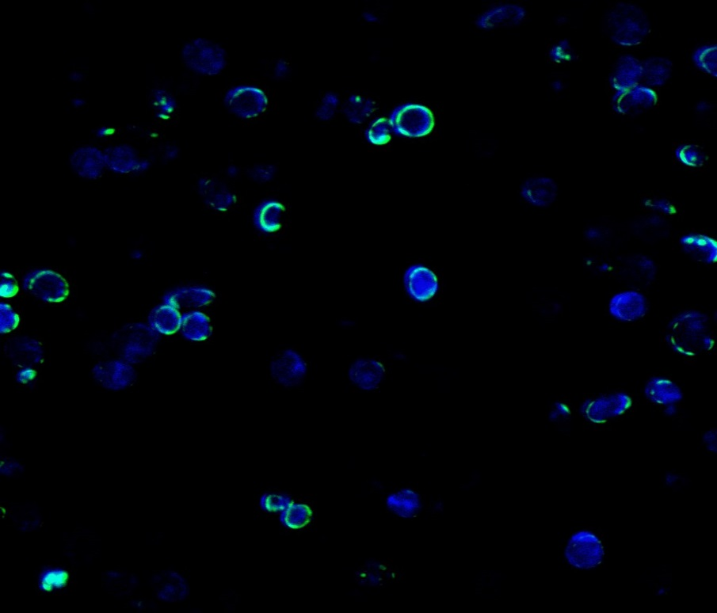
Microalgae and Polyphosphate
Polyphosphates are a form of condensed phosphate found in nearly all species from bacteria to mammalian cells
Separated into distinct compartments with diverse functions
Stored in replete conditions, scavenge when starving
Protein machinery largely unknown- difficulties modelling
Can we manipulate this machinery to improve HRAP function?

Slide 4
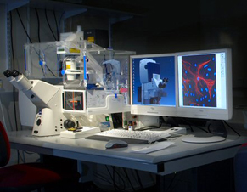
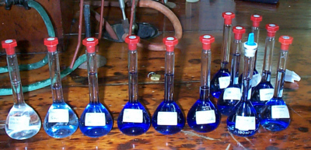
The practical side
Methods development- want to be able to quantitatively and qualitatively assess polyphosphate content
Visualisation
Extraction
Investigating link between polyphosphate utilisation and previously studied gene psr1 in Chlamydomonas
http://wwwchem.uwimona.edu.jm/lab_manuals/c10expt36.html

Slide 5
Future work/Applications
Through genetic tools (directed evolution, CRISPR) or environmental influence, may be able to produce microalgae with enhanced phosphorus uptake capacity
Better understanding of kinetics and available pathways to enhance current model of phosphorus uptake

Slide 6
Thanks to…
Prof. Rod Scott
Dr Tom Arnot
Dimitrios Kaloudis
Mais Sweiss
Bath Plant Lab
And you all for listening to me
Any questions- find me at my poster

